Slide 1
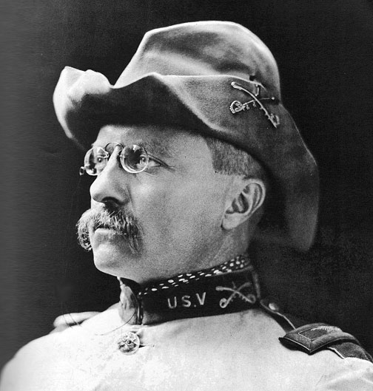
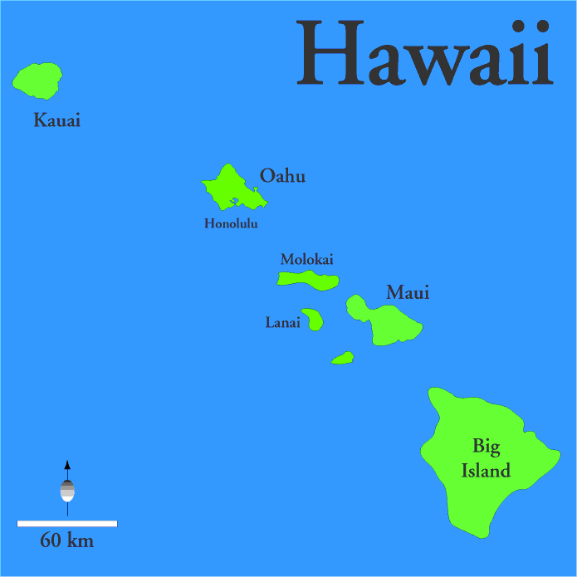
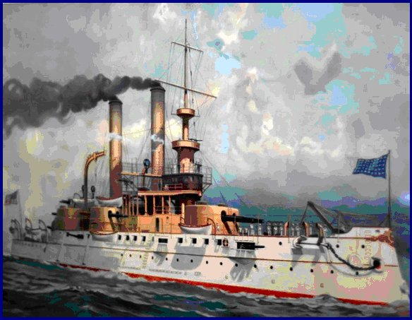
American Imperialism
1872-1920

Slide 2
Leadership

Slide 3
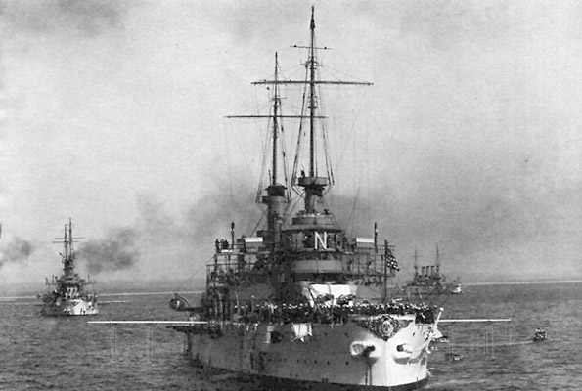
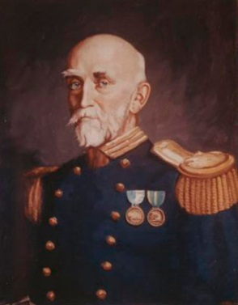
American Imperialism
Imperialism: Economic and political take over of a weaker nation or territory
Why: To compete with the other major powers of the World (Britain, France, Germany) for land and resources.
How: U.S. Navy Great White Fleet
Admiral Alfred T. Mahan …The Influence of Sea Power Upon History,

Slide 4
Causes of Imperialism
1. Feeling of superiority of American culture (Anglo-Saxons)
2. Belief in a need for a large navy to control overseas bases and resources
3. Belief that the economy needed overseas markets

Slide 5
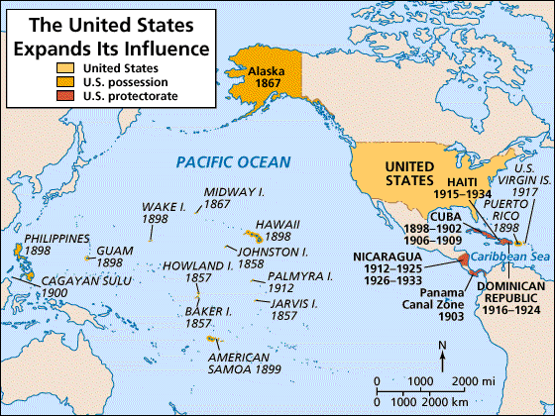
2. Military/Strategic Interests
Alfred T. Mahan → The Influence of Sea Power on History: 1660-1783

Slide 6
Perry Opens Japan
The U.S. felt that we would benefit from a trading partner in Asian such as Japan.
Japan refused to trade with western nations in an attempt to preserve their traditional culture.
U.S. Navy – Admiral Matthew Perry bombarded Tokyo Bay and forced the Japanese government to start trading with American merchants

Slide 7
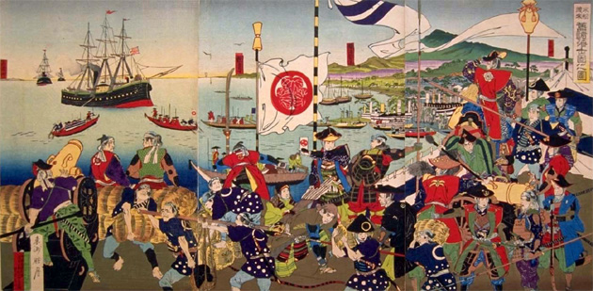
1853- Admiral Perry Bombards Tokyo

Slide 8
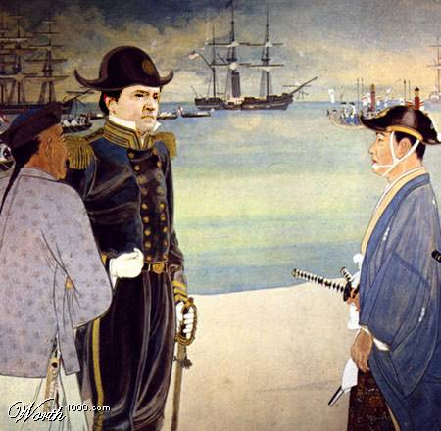
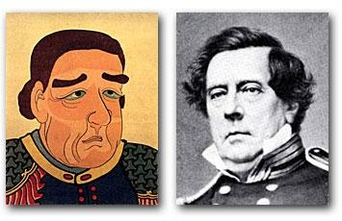
Commodore Matthew Perry Opens Up Japan: 1853
The Japanese View of Commodore Perry

Slide 9
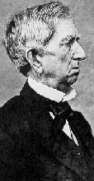
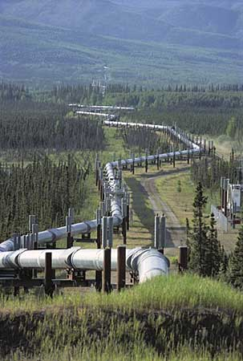
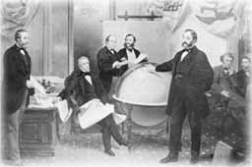
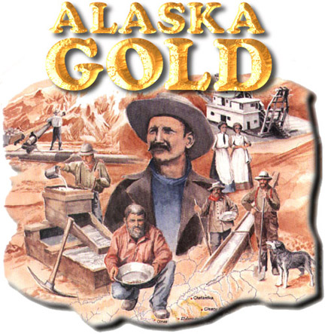
Purchase of Alaska
Seward purchased Alaska from Russia for $7.2 Million 1867
William Seward
Secretary of State
Alaska pipeline
Gold & oil was found in Alaska

Slide 10
Hawaii
Hawaii was important refueling and resupply base in the Pacific. It was also extremely rich in sugar cane.
Hawaii was a Monarch run by Queen Liliuokalani
American plantations owners on the Island with support of the Great White fleet forced Liliuokalani into house arrest and the U.S. annexed the Islands in 1898.
President Grover Cleveland opposed this but once out of office his predecessor President William McKinley supported the take over in 1898

Slide 11
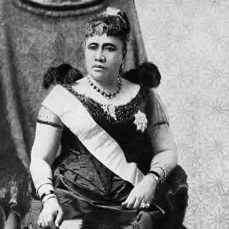
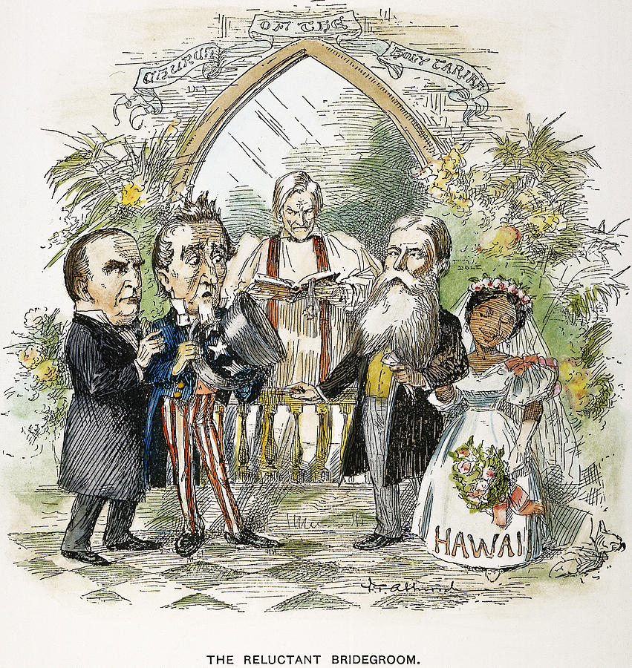
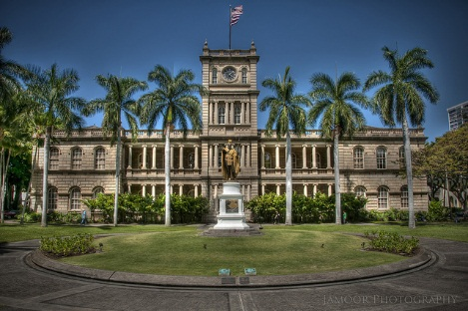
Queen Liliuokalani
Iolani Palace

Slide 12
Yellow Journalism
Over exaggerated reports about Spanish atrocities in Cuba to attract readers.
William Randolph Hearst (New York World and Journal)
Joseph Pulitzer (The World)

Slide 13
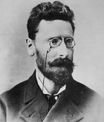
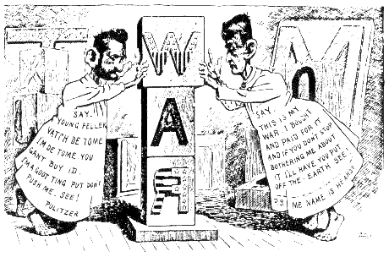
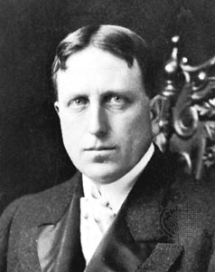
“Yellow Journalism”
Joseph Pulitzer
Hearst to Frederick Remington:
You furnish the pictures,
and I’ll furnish the war!
William Randolph Hearst

Slide 14
Spanish American War
Causes:
Cuban forces had rebelled against Spain
Americans had a desire to protect their investments and trade with Cuba
Yellow Journalism persuaded public opinion
Explosion of the U.S.S. Maine

Slide 15
U.S.S Maine
Battleship was sent to Havana Harbor to rescue American refuges caught in the Cuban war with Spain
The boat exploded while in the Harbor in 1898. It was blamed on Spanish forces and was an immediate cause for war with Spain over Cuba
In all reality it is more likely that a boiler on the ship surst rather that a Spanish bomb.
Yellow journalism helped blame it on Spain

Slide 16
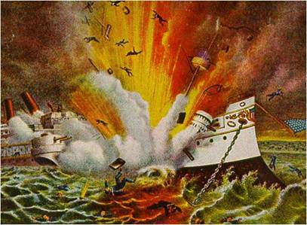

Slide 17
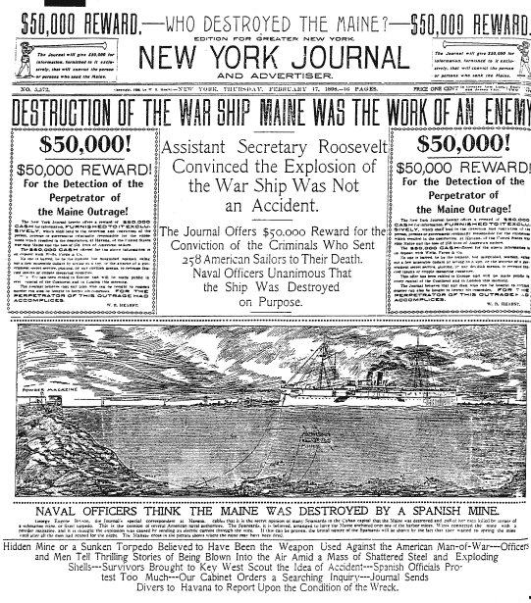

Slide 18
Spanish American War
May 1898 – Admiral Dewy takes Manila Bay and captures the Philippines from Spain.
Spanish Army was defeated in Cuba by Colonel Teddy Roosevelt and the Rough Riders at the Battle of San Juan Hill forcing Spanish troops to surrender.
1898- U.S. Takes
Philippines
Cuba
Guam
Puerto Rico
Hawaii (Prior to the War)

Slide 19
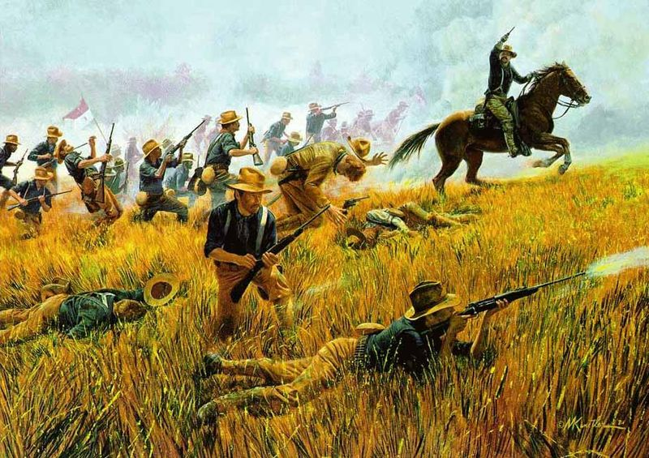
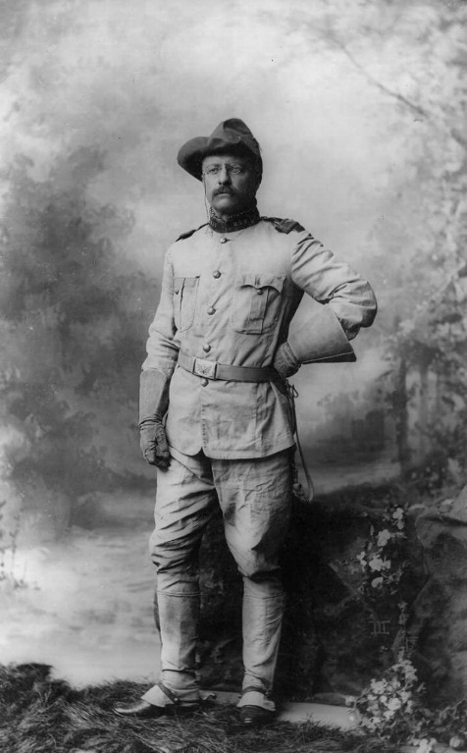
Teddy Roosevelt and Rough Riders at San Juan Hill

Slide 20
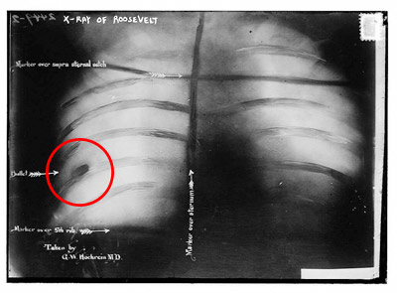
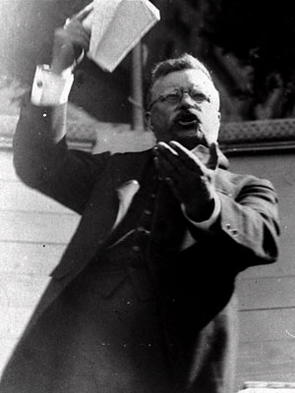
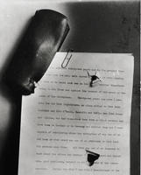
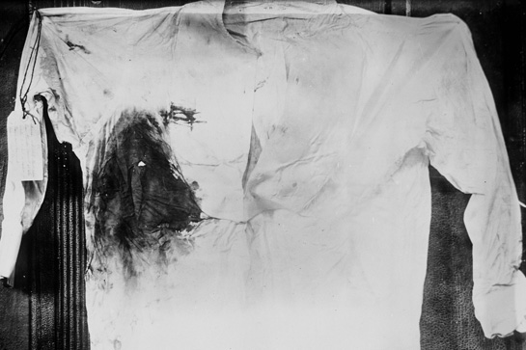

Slide 21
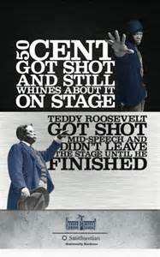

Slide 22
Platt Amendment
Cuba given Independence following war
Could not make treaties with other nations
U.S. naval stations in Cuba
No Cuban debt to keep other nation from intervening on the Island

Slide 23
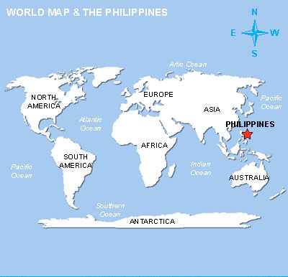
Philippines Islands

Slide 24
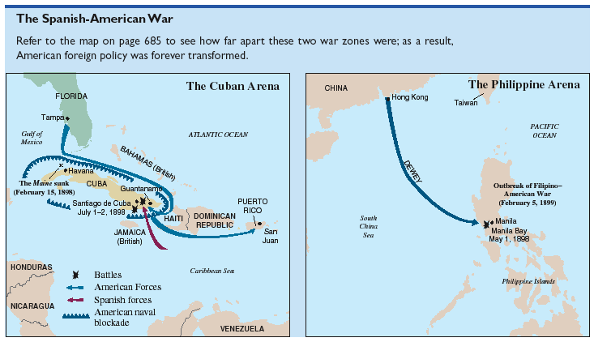
The Spanish-American War (1898):
“That Splendid Little War”

Slide 25
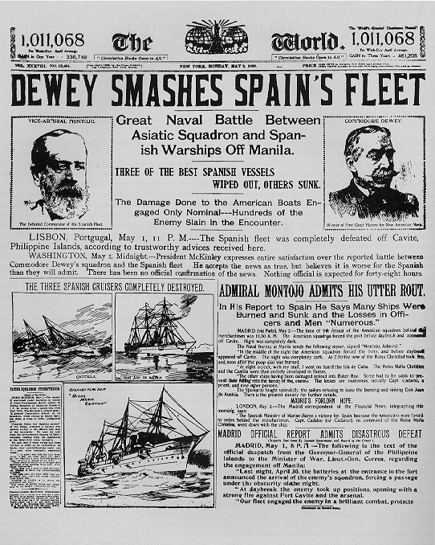
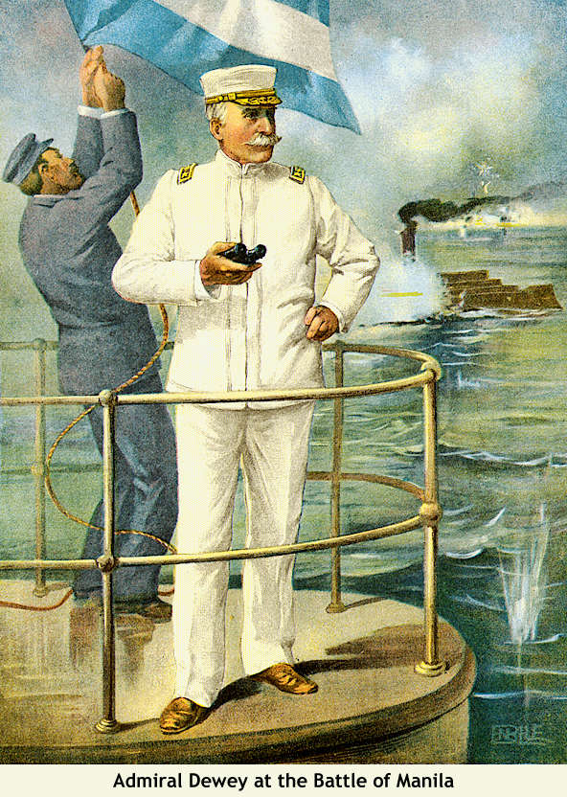
Dewey Captures Manila!

Slide 26
Rebellion in the Philippines
Gorilla forces under Emilio Aguinaldo fight back against American annexation of the Island
4,300 American troops killed between 1898 and 1901
American forces captures Aguinaldo and put down the rebellion
American culture forced on the Philippines
1946 The U.S. allows the Philippines Islands to become independent.

Slide 27
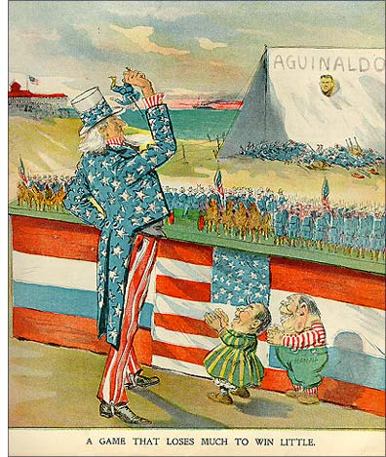
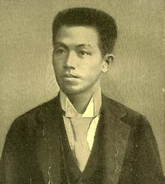
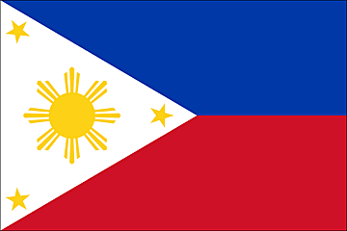
Emilio Aguinaldo
Leader of the Filipino
Uprising.
July 4, 1946:
Philippine independence

Slide 28
President Theodore Roosevelt
1901 President William McKinley killed in Buffalo NY by anarchist Leon Czolgosz
.
Roosevelt as Vice President takes over
Wants to create a canal to connect Atlantic and Pacific Ocean to increase speed of world trade
Roosevelt offers Colombia 10 million and yearly rent for right to construct a canal
When Columbia says no, The U.S. funds and supports a rebellion in Panama and recognizes the independence of the country to create a canal.

Slide 29
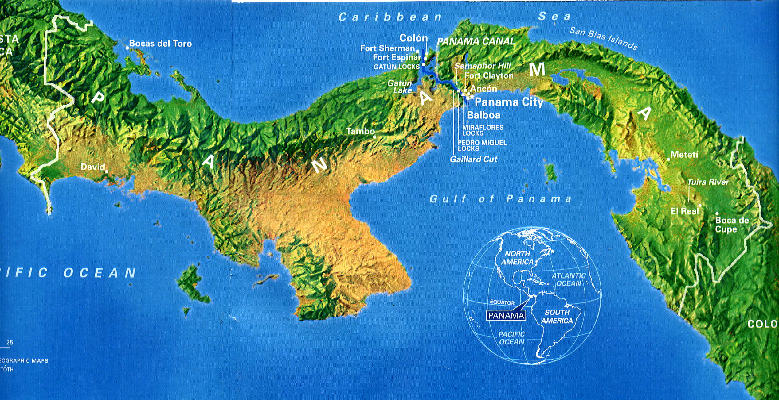
Panama Canal (Hay-Pauncefote Treaty)

Slide 30
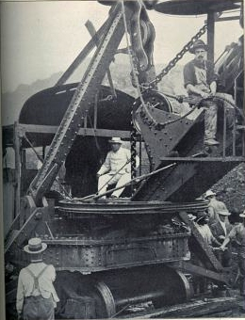
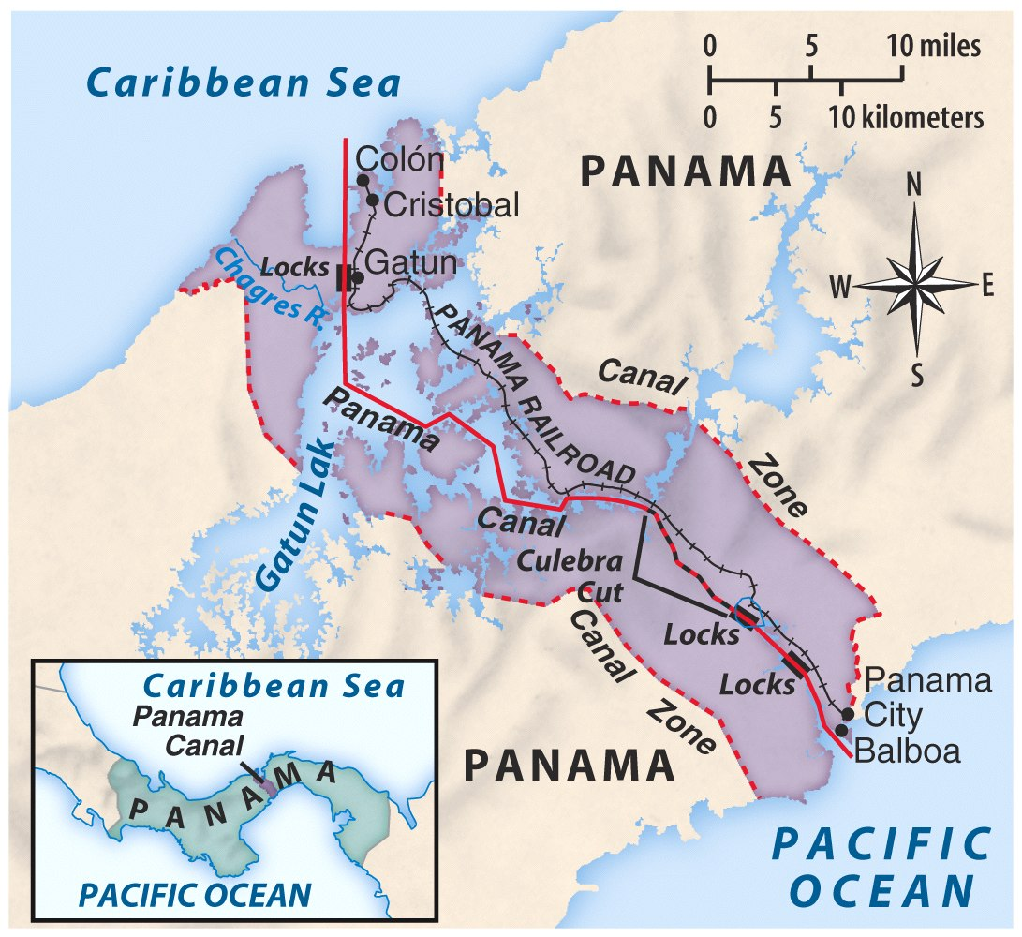
Panama Canal
TR in Panama
(Construction begins in 1904)

Slide 31
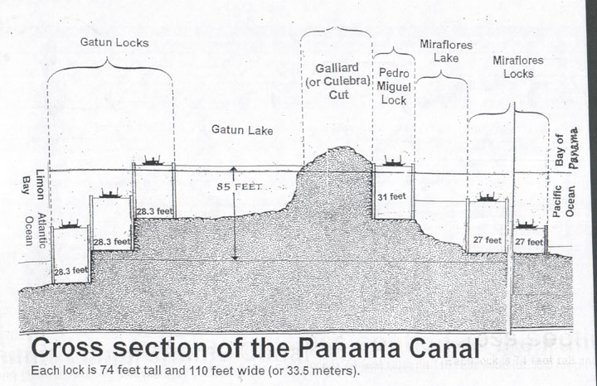

Slide 32
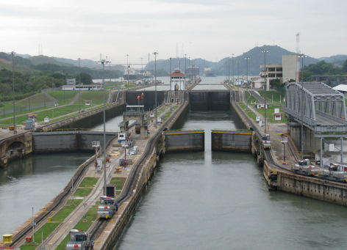
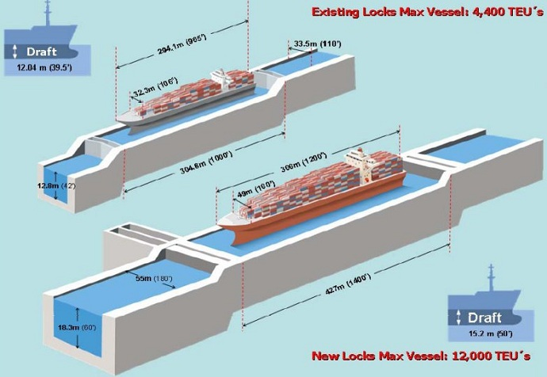

Slide 33
Call it what it is!
Colonies
a number of people coming from the same country, or speaking the same language, residing in a foreign country or city, or a particular section of it
Protectorate
imperial power allowed local rulers to stay in control & protect them against rebellions & invasion
-these “rulers” had to accept “advice” on how to govern their countries
Territories
a region or district of the U.S. not admitted to the Union as a state but having its own legislature, with a governor and other officers appointed by the President and confirmed by the Senate.

Slide 34
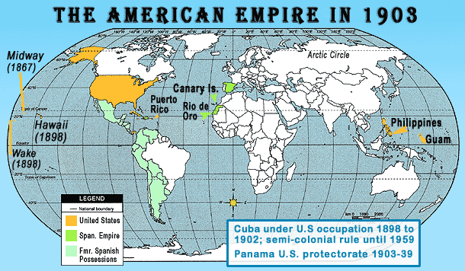

Slide 35
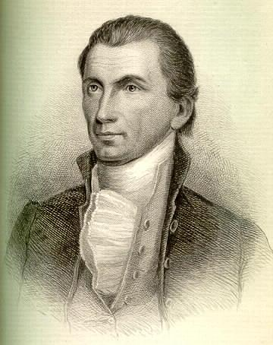
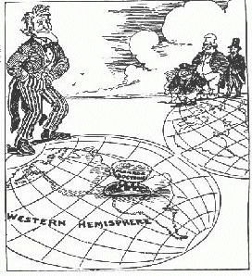
Monroe Doctrine
US told Europe not to establish new colonies in N. or S. America & we would not get involved in their affairs

Slide 36
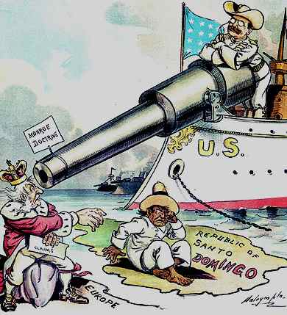
Roosevelt Collary - “Speak softly and carry a big stick”

Slide 37
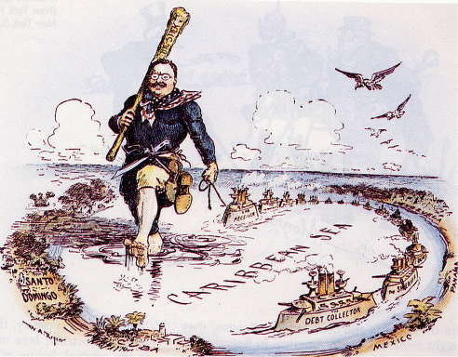

Slide 38
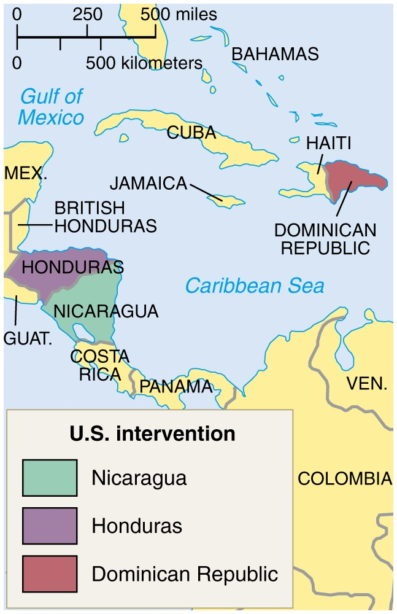
Taft’s “Dollar Diplomacy”
Improve financial
opportunities for American businesses.
Use private capital to
further U. S. interests
overseas.
Therefore, the U.S.
should create stability and order abroad that would best promote America’s commercial interests.

