Slide 1
Ch. 13 Urban American
Immigration:
Old Immigrants (Before 1890) Western Europe
German
English
New Immigrants (After 1890) Eastern Europe
Italians
Polish
Serbs
Russians
Why would Immigrants what to leave their old countries and come to the U.S.?

Slide 2
Push and Pull Factors
Push: reasons to leave old nation
Ex: (war, famine, poor government, crime, overpopulation, lack of jobs or education)
Pull: reasons to come to the United States
Ex: (land, education, religious freedom, democracy, family, opportunity)

Slide 3
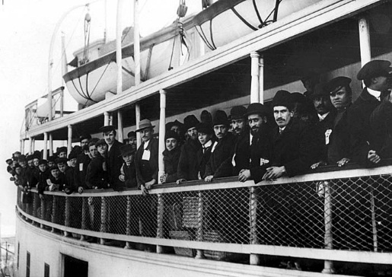
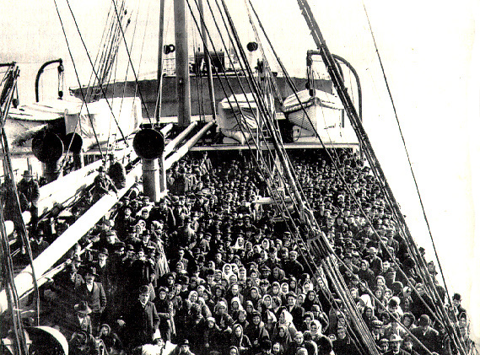
14 day voyage in steerage
Ellis Island, New York (1892-1954)

Slide 4
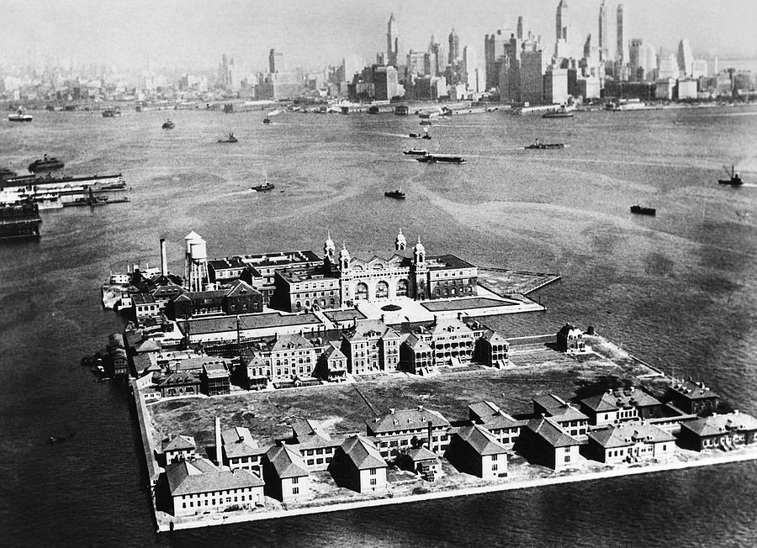

Slide 8
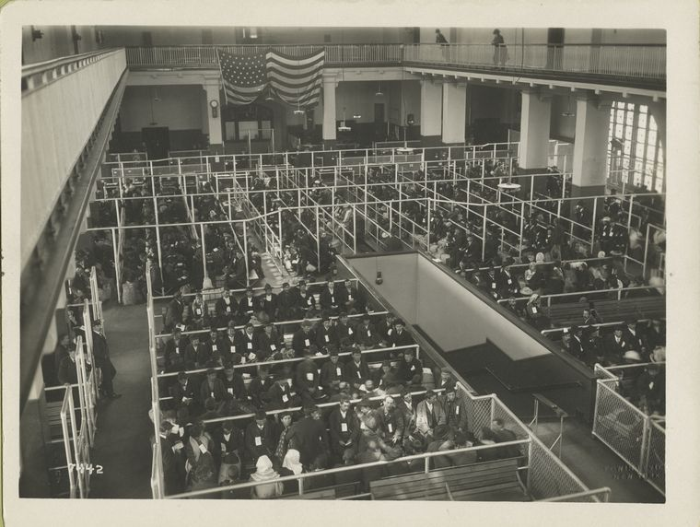

Slide 9
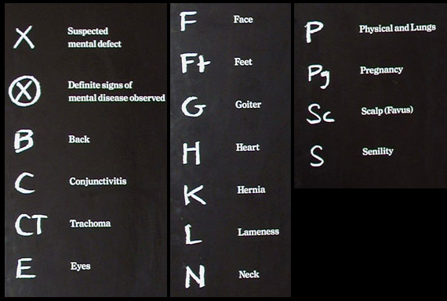
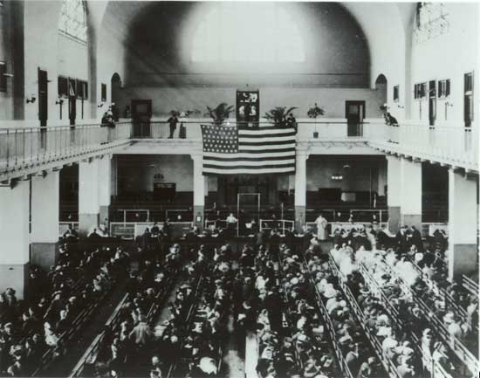

Slide 11
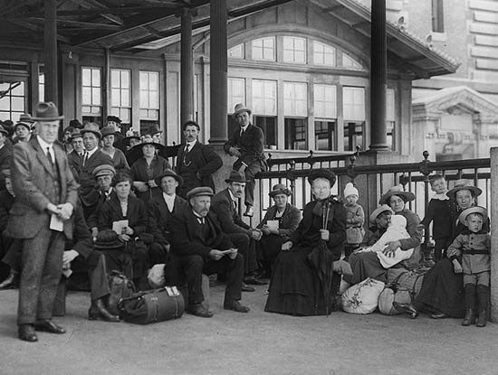
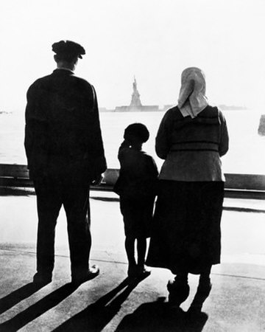

Slide 12
Steps to Citizenship
1. Ellis Island steps
2. Six Second metical examination
(Lice, Phenomena, Trachoma and heart and lungs)
3. Mental examination ( puzzles)
4. $ 25 dollar minimum
What challenges would immigrants face?

Slide 13
Citizenship Today
1. Submit Your Complete U.S. Citizenship Application:
To be able to apply for citizenship through naturalization, you have to meet the following requirements. You should:
Be 18 years of age or above.
A lawful permanent resident for 5 years (3 years if married to a US citizen).
Have maintained continuous residence during the past 5 years (3 years if married to a US citizen).
Have maintained physical presence during the past 5 years (3 years if married to a US citizen).
Have good moral character.
Have basic knowledge of English.
Have basic knowledge of US government and history.
Be willing to take the Oath of Allegiance.
2. Get Fingerprinted (Biometric Services):
Receive an application receipt notice from the USCIS acknowledging that your application has been received.
Go to the local Application Support Center (ASC) as specified in the letter from the USCIS on the scheduled date and time to get your fingerprints taken.
Conduct a standard background check
Send any additional documents to the USCIS that they may have requested in the letter

Slide 14
Nativism
Dislike of new immigrants due to different language, customs and religion
Ex: Chinese Exclusion Act (1882) prohibited Chinese immigrants from entering the U.S. for 10 years

Slide 15
Political Machines (Tammany Hall and William Boss Tweed)

Slide 22
Gilded Age
Social Darwinism: Idea of Individualism, that Americans if they worked hard could rise from poor to rich in society. Strong will grow and survive… poor will fall.
Gospel of Wealth: Philanthropy idea of Andrew Carnegie that the extremely rich had a duty to give back and help out their fellow man.

Slide 23
Popular Culture
Saloons
Amusement Parks and Sports
Coney Island
Professional Baseball
College Football
Basketball Invented
Ragtime- Blended African American and Banjo/Country Music

Slide 24
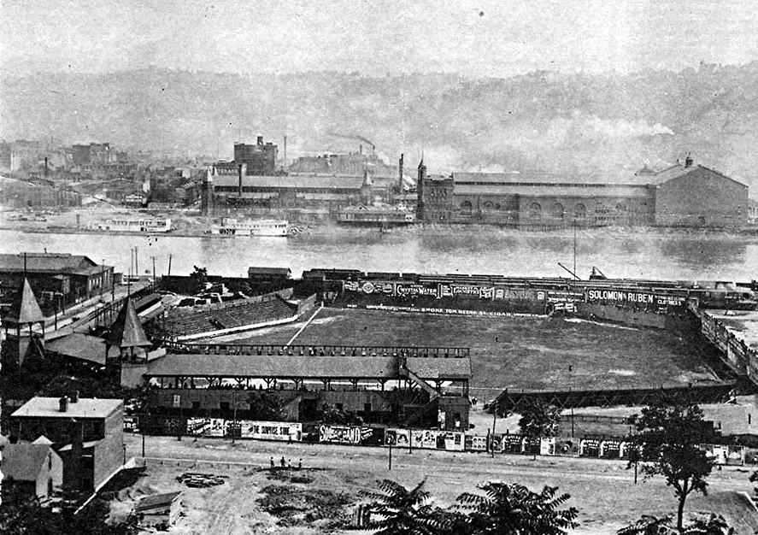
Exposition Park III, built in 1890 and shown here in 1905, was home of the Pittsburgh Pirates from 1891 to 1909.

Slide 25
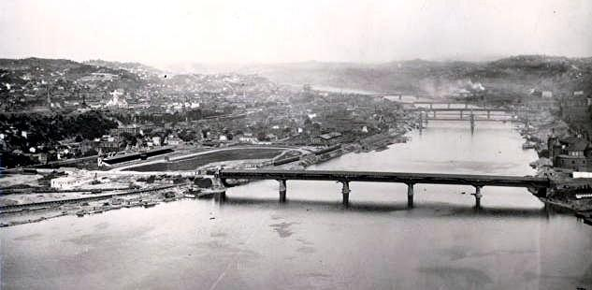
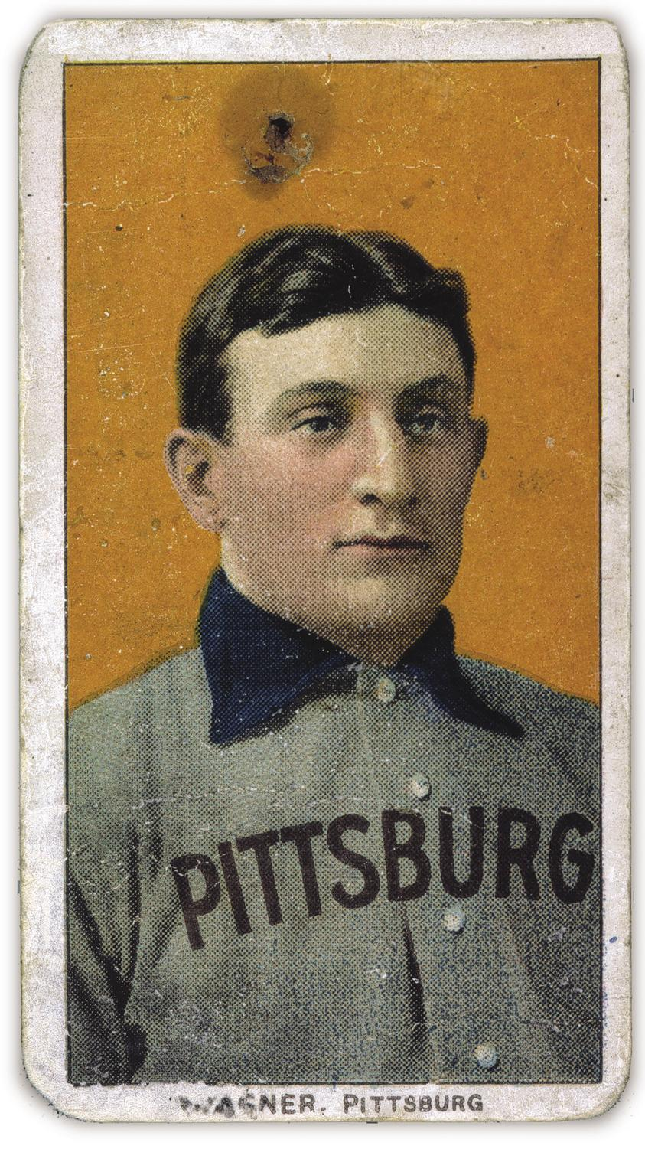
1909 Honus Wagner “Flying Dutchmen (Card sold for 2.8 million in 2011

Slide 28
Spoils System
“spoils of office”- Government jobs handed out following an election
Patronage- Giving jobs to those who supported your campaign
James Garfield is assassinated by Charles J. Guiteau in 1881
Guiteau was turned down several times for a job by Garfield
The Assassination highlighted corruptness in politics
Pendleton Act- requires some gov’t jobs be filled by qualified workers instead of political friends
Civil Service System- Requiring qualifications for public jobs

Slide 29
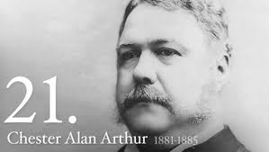
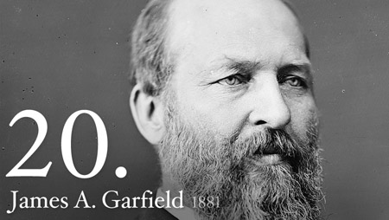
Republican Split
Stalwarts- Support Patronage Chester A Arthur (VP)
Halfbreeds- Oppose Patronage; James Garfield
Stalwarts- Support Patronage Chester A Arthur (VP)
lfbreeds-

Slide 30
Pendleton Act
In response to Garfield's assassination required written examinations for government jobs

Slide 31
Election of 1884
Democrat Grover Cleveland
Reformer with a reputation for honesty
Republican James Blaine
Rumored to have accepted bribes
Mugwumps- Republicans so unhappy with Blaine’s nomination that they supported Cleveland

Slide 33
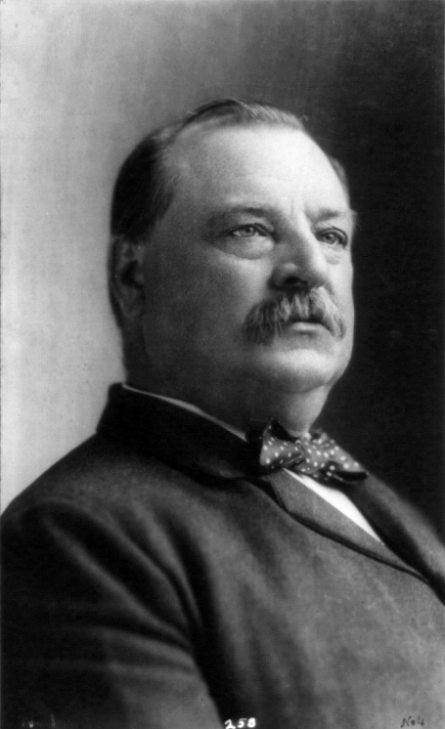
President Cleveland
Not Spectacular
Created the Interstate Commerce Commission (ICC)- first federal law to regulate interstate commerce
Big debates over Tariffs

Slide 34
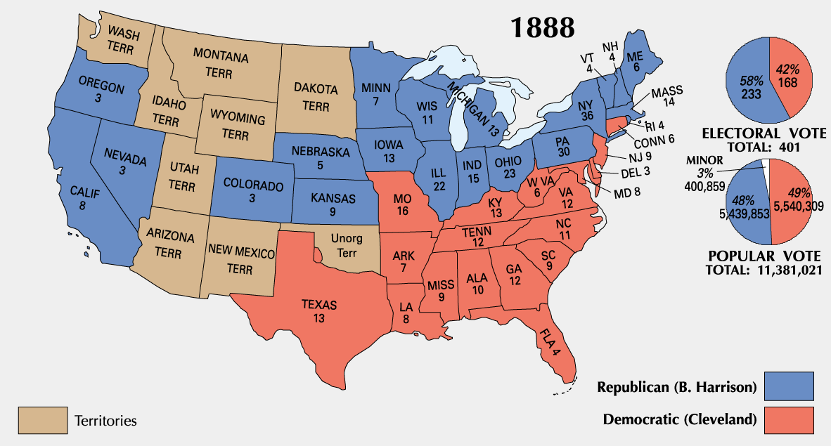
Election 1884
Republican Benjamin Harrison- Supported High Tariffs
Democrat Grover Cleveland-Opposed High Tariffs

Slide 35
Fighting Big Business
McKinley Tariff
Raised tariffs on many goods
Caused an increase in prices of goods
Benjamin Harrison is blamed
Sherman Antitrust Act
Outlaws Monopolies
Law does not have teeth

Slide 36
Helping Urban Poor
The Salvation Army and YMCA- Combines faith and the interest in reform
The Settlement House Movement
Houses to help poor people; specifically women
Jane Addams- Hull House
Public Schools
Americanization- Teaching English and American History
Discipline and work ethic
Punctuality, neatness, and efficiency
Three R’s-Reading writing , Arithmetic

Slide 37
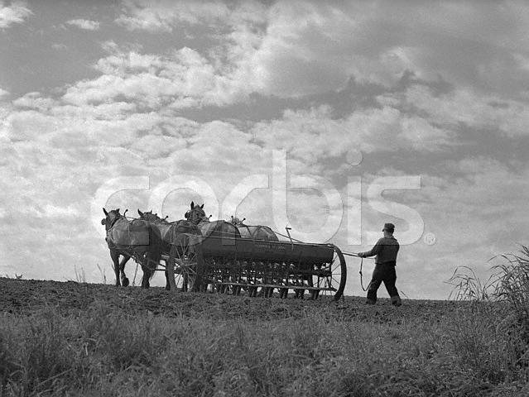
Populism:
What?
Political movement that tried to help out the nation’s struggling farmers

Slide 38
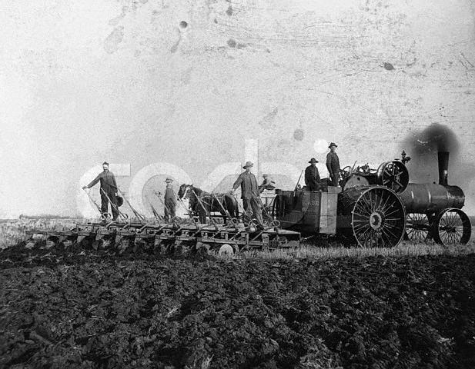
Populism
Why?
Farmers were in trouble because of...
1. Mechanization - More machines = more debt
2. New Farm Land More land (on credit) = more debt

Slide 39
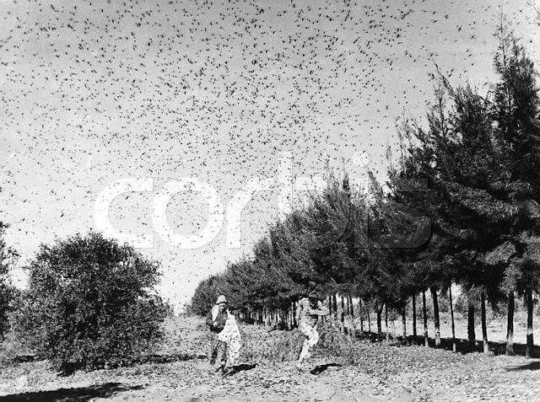
Populism
Why?
Farmers were in trouble because of...
3. Specialization of Crops - Farmers only raise one crop (leads to trouble if that crop has problems)
4. Disasters - floods, boll-weevil, grasshoppers

Slide 40
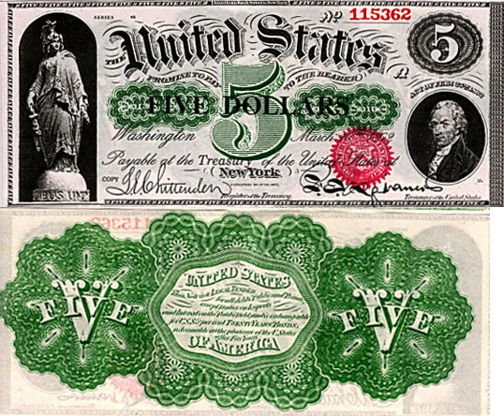
Follow the Money $$$$$$$$$
To adjust to economic crisis some farmers wanted:
Greenbacks increased
-paper money that could be exchanged for gold or silver coins
-Increase of money supply without the increase of goods causes inflation or the decrease in the value of money
-paper money lost value and prices of goods skyrocketed
Other farmers called for minting more silver coins

Slide 41
Federal Reserve
From the Treasury;
"Federal Reserve notes are not redeemable in gold, silver or any other commodity, and receive no backing by anything. Redeemable notes into gold ended in 1933 and silver in 1968. The notes have no value for themselves, but for what they will buy. In another sense, because they are legal tender, Federal Reserve notes are "backed" by all the goods and services in the economy."
What the government, via the Treasury and the Federal Reserve, really did in 1971 was coerce you to accept something (Federal Reserve notes) that used to be redeemable for gold and/or silver but now aren't redeemable at all.
Article Source: http://EzineArticles.com/2528220

Slide 42
Follow the Money $$$$$$$$$$$$$
The concept of inflation and deflation.
Inflation occurs when prices increase and is typically followed by an increase in the money supply and available credit.
Deflation is the opposite as it occurs when prices move lower due to a drop in consumer spending as companies cut prices to spur consumer purchases. Deflation is commonly seen during economic recessions and depressions.
http://www.mysmp.com/video/bonds/understanding-inflation-and-deflation.html

Slide 43
The Grange
What?
Farmer’s Union founded by Oliver Kelly (MN)
Cooperative movement - farmers pooled their money to make shared purchases of machinery, supplies, insurance, etc.
How?
Worked for pro-farmer laws
Ex. Interstate Commerce Act - regulated rates of railroads

Slide 44
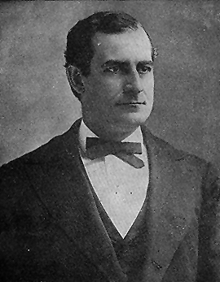
William Jennings Bryan (1860-1925)
The “Great Commoner”

Slide 45
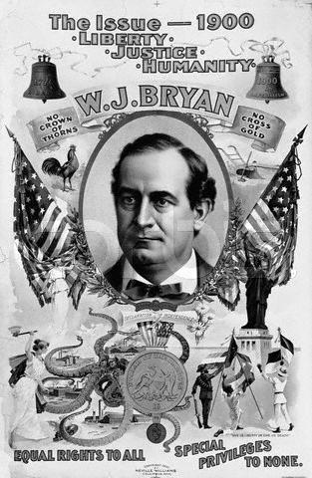
A Populist President?
William Jennings Bryan
Ran as a Populist President (people’s party in 1896 on platform of Free Silver
Big business opposes his run, Republicans win the white house, & Populists fade away
“You shall not press down upon the brow of labor this crown of thorns. You shall not crucify mankind upon a cross of gold” -- W.J. Bryan

Slide 47
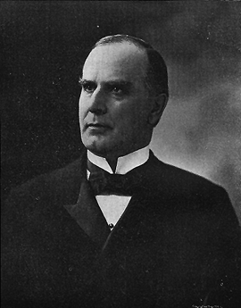
William McKinley (1843-1901)

Slide 48
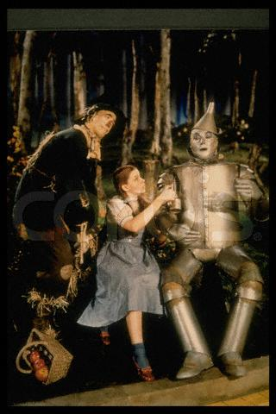
The Wizard of Oz
Written by Active Populist L. Frank Baum
Most things in the book represent something important to the populist movement

Slide 49
The Wizard of Oz
Basic Symbols:
Ruby Slippers
- In the book, were actually “Silver Slippers” (magic of Free Silver)
Yellow Brick Road
- “Gold” many dangers for regular people (like Dorothy) – Also the gold Standard
Oz
- Abbreviation for Ounce (way gold is measured)

Slide 50
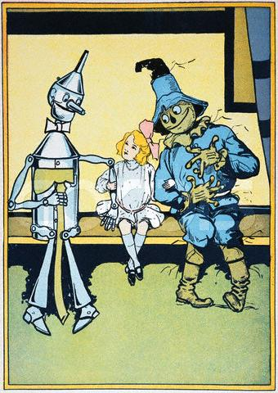
The Wizard of Oz
Characters:
Dorothy
- Everyman
Scarecrow
- Farmers
Tin Man
- Industrial Workers

Slide 51
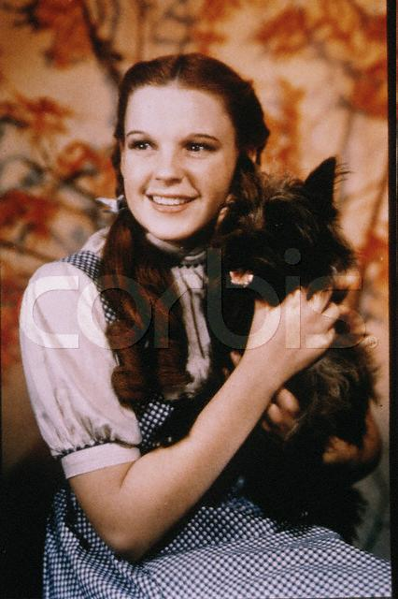
The Wizard of Oz
Characters:
Lion
- William Jennings Byran (a pacifist)
Toto
Temperance Activists (allies of the Populists)
Wizard
- President of the United States

Slide 52
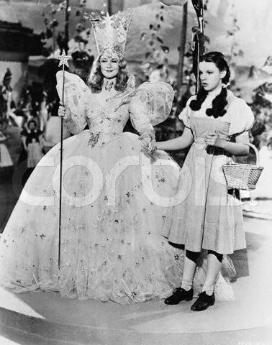
The Wizard of Oz
Places:
Emerald City
- Washington D.C. (in the book, the color came from Green Glasses that everyone wore, a trick)
Good Witches of North & South
- Directions where Populists had friends (Midwest and South)
http://www.youtube.com/watch?v=zJ6VT7ciR1o&NR=1

Slide 53
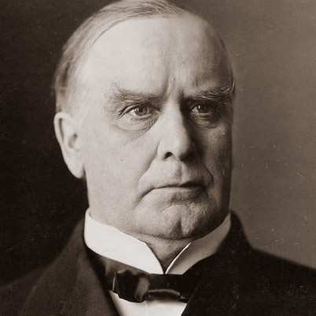
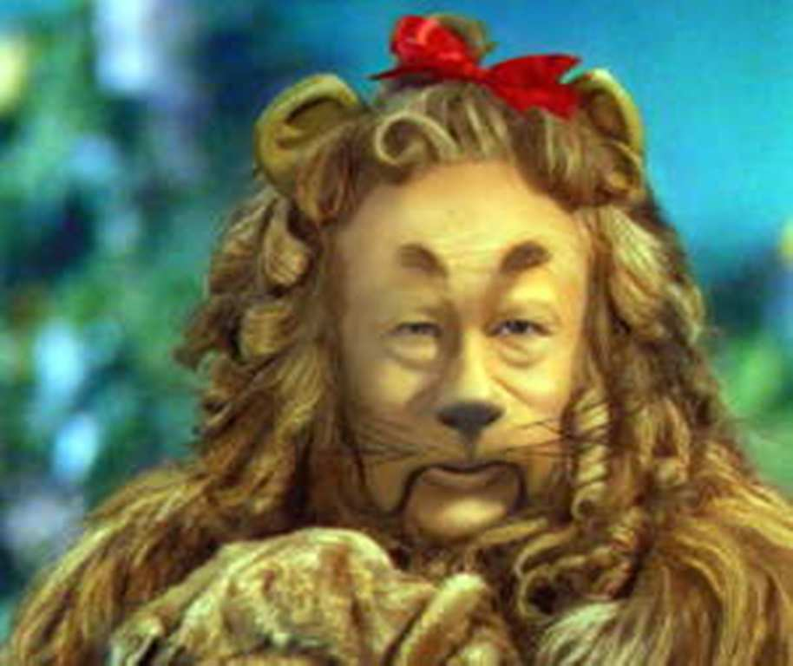
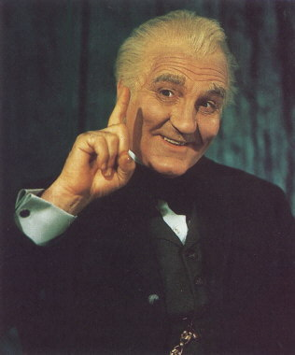

Slide 54
The 1896 Election
After the election of 1892, a major railroad company failed, triggering the Panic of 1893.
Stock prices fell and millions lost their jobs. President Cleveland blamed the Sherman Silver Purchase Act, which required the government to buy silver with paper money redeemable in either gold or silver.
Silver was still an issue in the 1896 election, when Republicans nominated William McKinley, who favored the gold standard and Democrats chose William Jennings Bryan, who defended silver.
Bryan made a dramatic speech saying using the gold standard was like crucifying mankind on a “cross of gold.”
This speech won Bryan Populist support, but terrified business leaders gave money to the Republicans, and McKinley won the election.

Slide 55
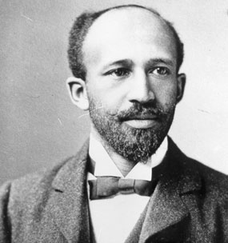
Racism in America
Booker T. Washington
W.E.B. DuBois

