Slide 1
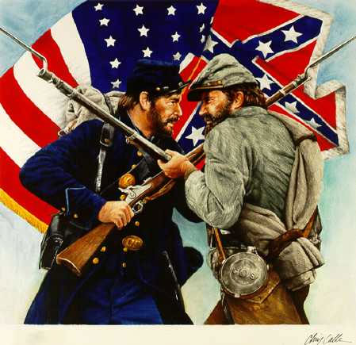
Ch.9 The American Civil War
1861-1865

Slide 2
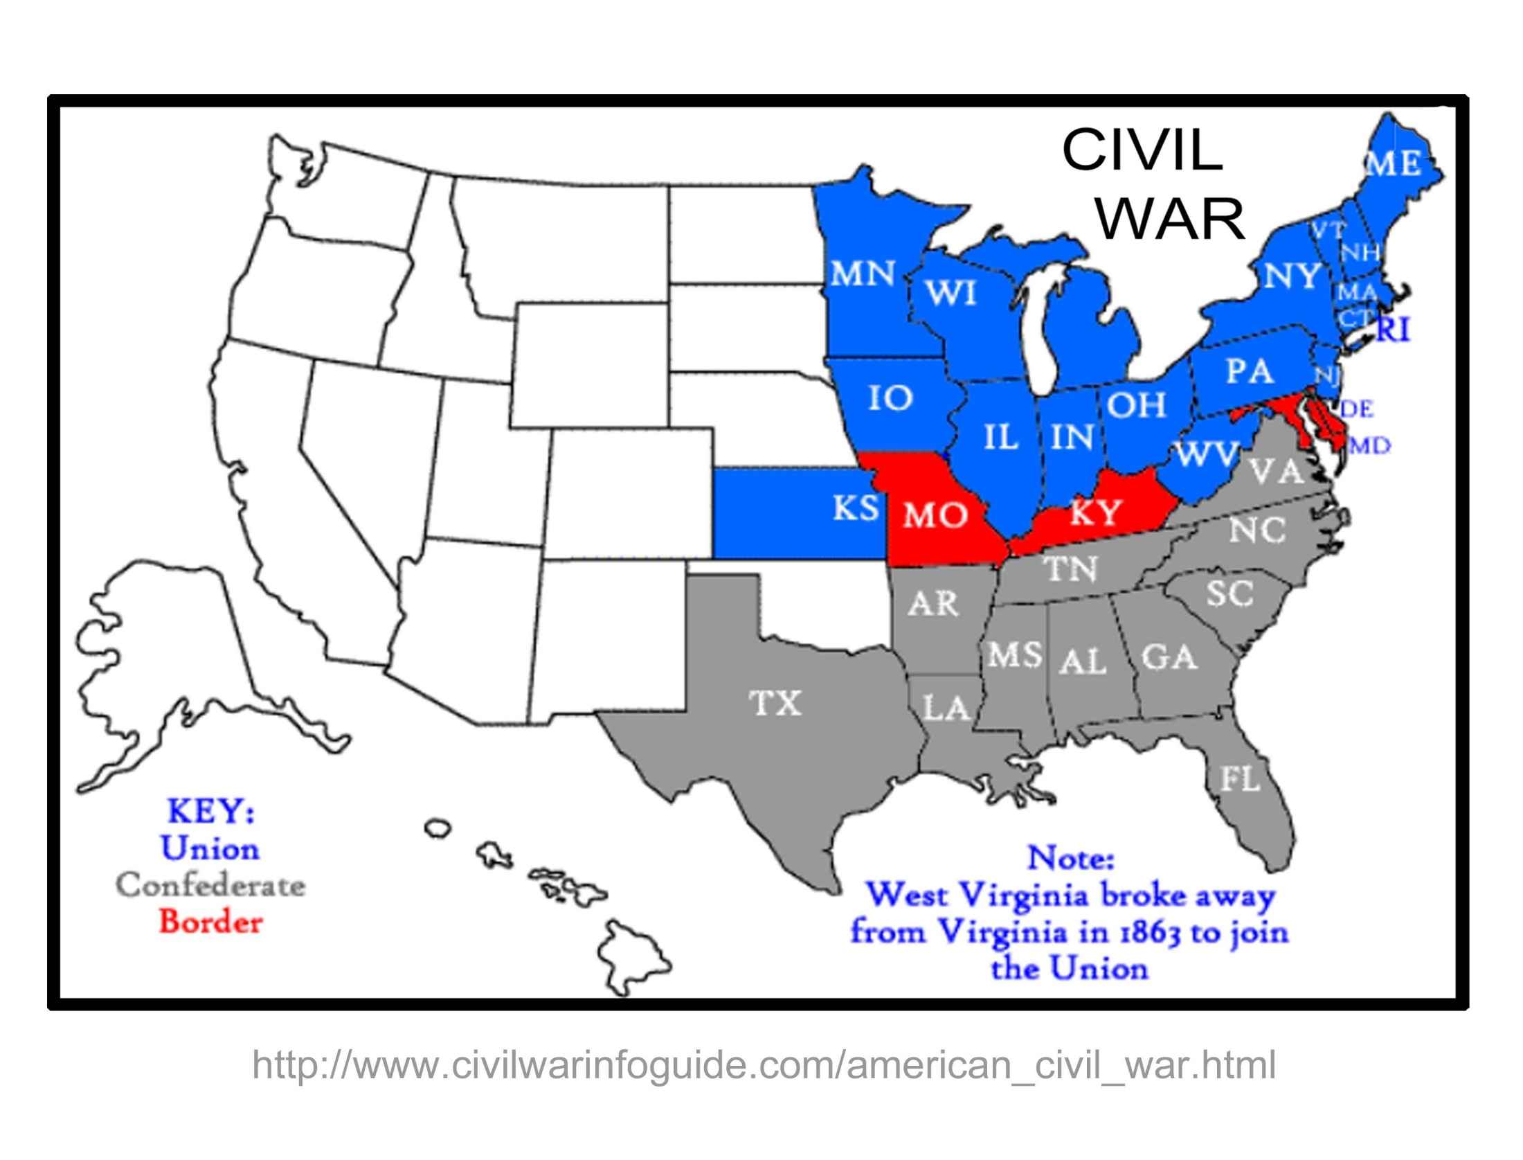

Slide 3
Causes of The Civil War
Underlying
Slavery
1846 - Mexican American War adds new lands to the United States. Threatens to change the balance of slave and free states in Congress.
1846 - Wilmot Proviso proposed no slavery in western territory. Upsets southern states.
1850’s - Popular Sovereignty (Idea to allow citizens in states to decide slavery issue).
1849 – Gold found in California –decision to make California free or slave state
Compromise of 1850 – California becomes a free states ….. Fugitive Slave Act passed
Kansas Nebraska Act – Citizens decide slavery issue
Bleeding Kansas – Fighting in Kansas over issue of slavery
Dred Scott Decision – Supreme Court upholds fugitive slave act
John Brown Raid – Anti-Slavery raid in Virginia
Immediate
1860 - Election of Abraham Lincoln – Angers southern states
1860 -Secession of South Carolina – Other states follow
1861 - Fort Sumter attacked by Southern forces –Start of hostilities

Slide 4
Strategies of War
North
Anaconda Plan
Use superior navy to blockade southern ports
Capture the Mississippi River to divide the south in half
Take the Confederate Capital of Richmond, VA
South
Defend southern territory and avoid major battles
Get help from a European country
Attack Washington, D.C.

Slide 7
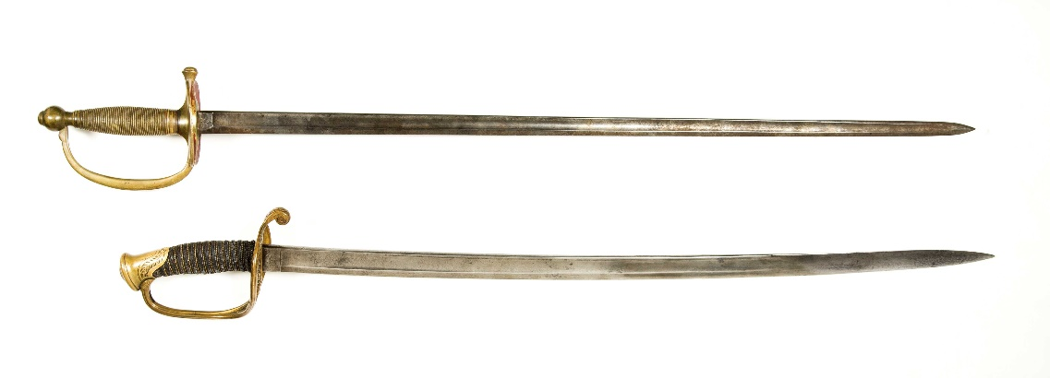
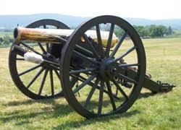
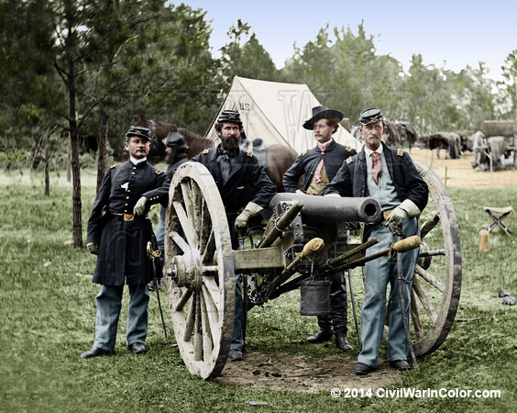
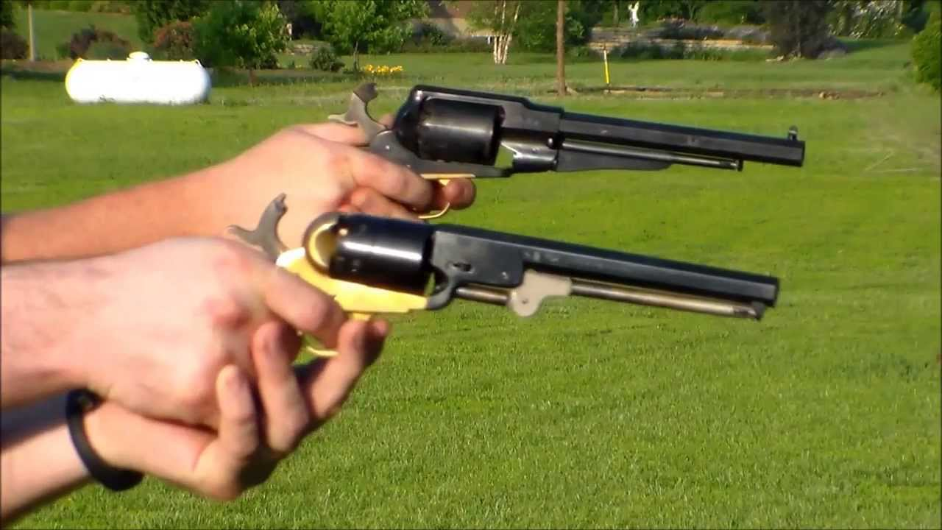
Weapons of the Civil War

Slide 8
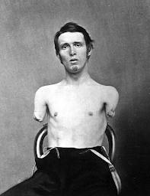
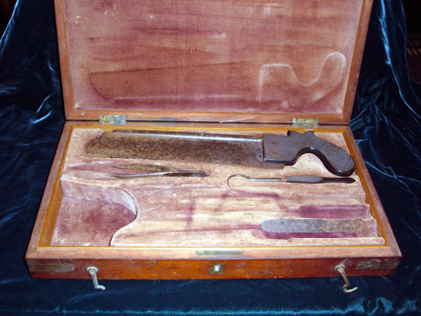

Slide 9
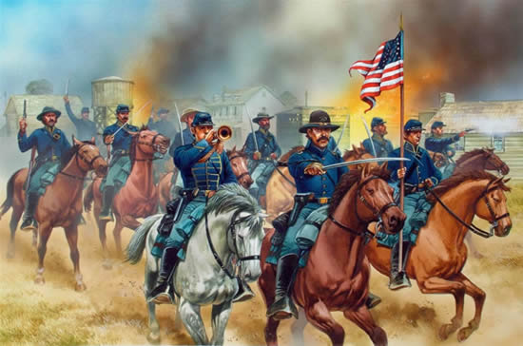
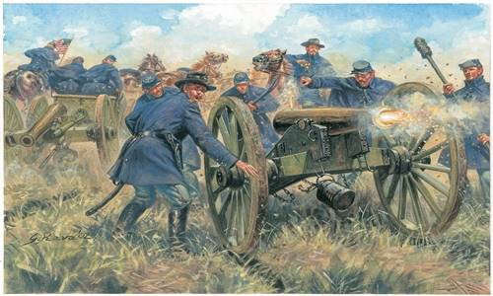
Infantry Cavalry Artillery

Slide 10
Advantages / Disadvantages
North
Higher population
More railroads
Manufacturing and industry
Iron and steel production
Stronger navy
Banking and finances
Government organization
Presidential leadership
South
Strong will to win
Knowledge of land
Well trained officers and soldiers

Slide 11
Major Civil War Battles (1863-1865)

Slide 12
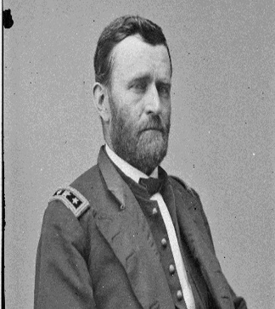
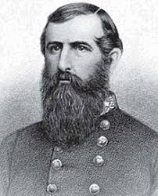
Vicksburg, Mississippi
(May 18 – July 4, 1863)
Leaders:
North: Ulysses S. Grant
South: John C. Pemberton
Factors:
Grant decided to lay siege to the city for 2 months eventually exhausting the south of food and supplies
Significance
Vicksburg gives the Union control of the entire Mississippi River and divides the Confederacy in half.

Slide 14
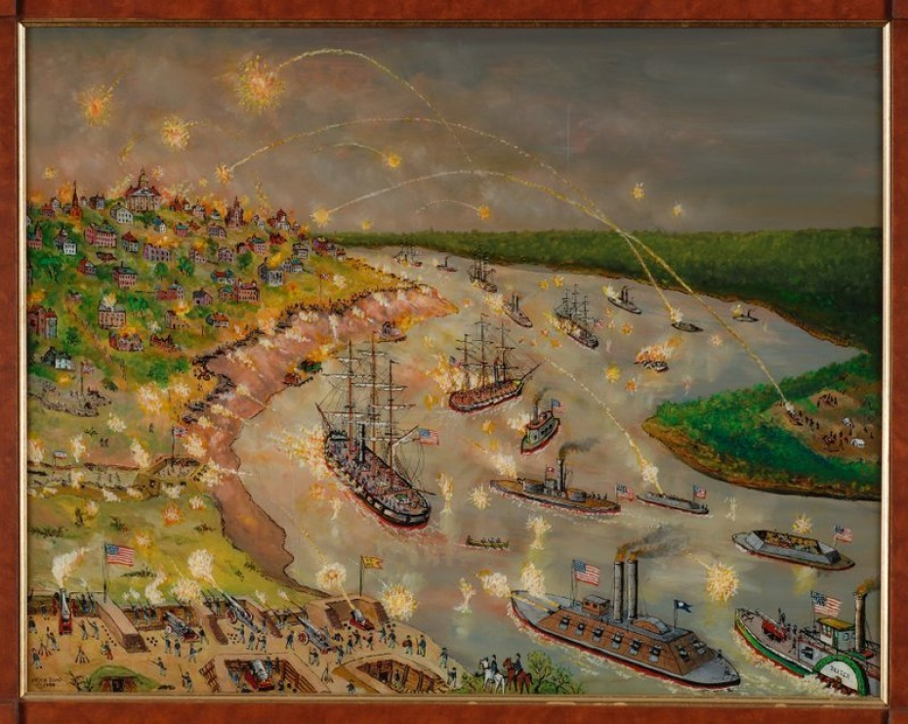
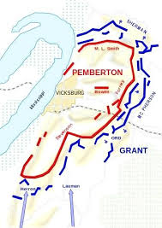
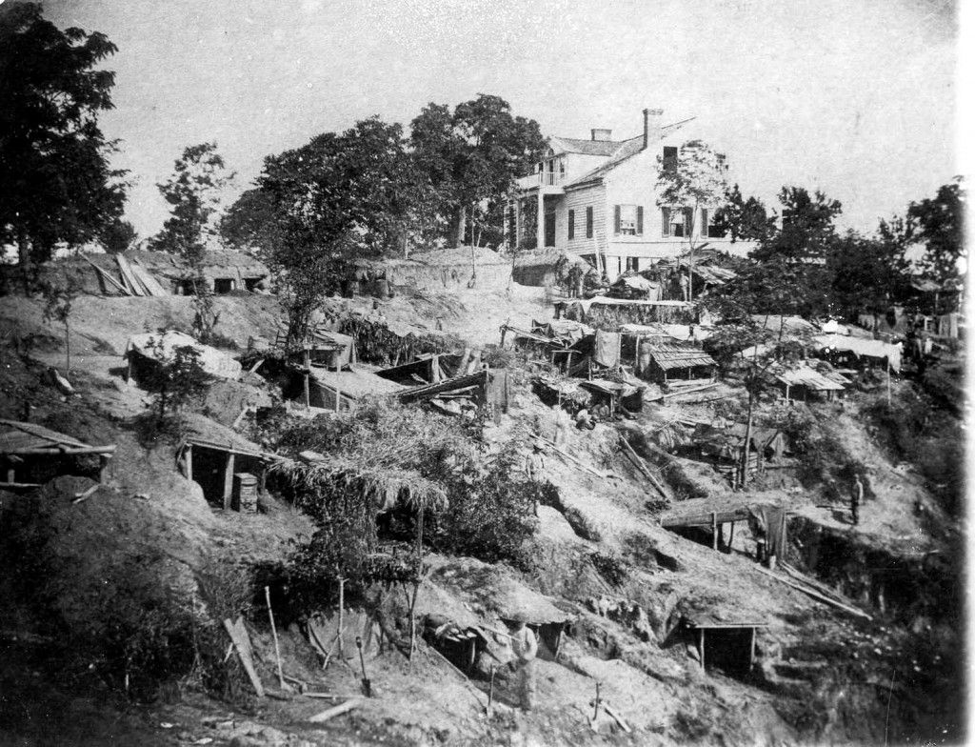

Slide 15
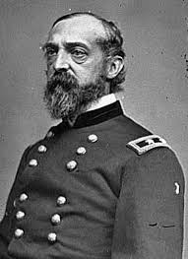
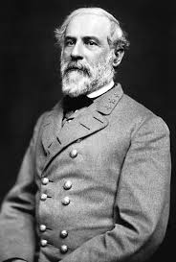
Gettysburg, Pennsylvania
July 1–3, 1863
Leaders
North: George Meade
South: Robert E. Lee
Factors:
Lee decided to invade the North after early Confederate success in the war. Lee is defeated on the 3rd day of the battle called Pickett's Charge
Significance:
Gettysburg is the turning point of the war and the South will be on the decline following the battle.

Slide 17
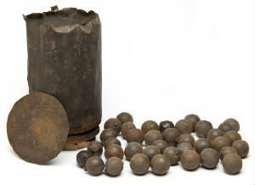

Slide 18
The Wilderness, Virginia
May 5– June 3, 1864
Leaders:
North: Ulysses S. Grant
South: Robert E. Lee
Factors:
Lee attempted to slow down Grant and his larger armies in the thick woods and brush of Virginia
Significance:
Grant relentlessly attacks Lee and eventually pushes his depleted armies back towards the Confederate Capital at Richmond, Virginia

Slide 23
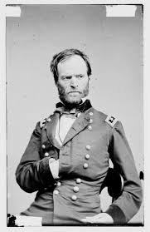
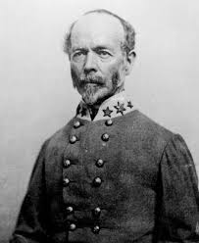
Battle of Atlanta, Georgia
May 7 – Sept 2, 1864
Leaders:
North: William Tecumseh Sherman
South: Joseph E. Johnston
Factors:
Sherman decides to march from Tennessee to Atlanta, Georgia in an all offensive attack.
Significance:
Atlanta falls which was the largest railroad and industrial city in the Confederacy

Slide 26
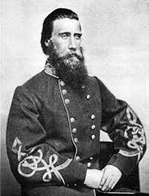
March to the Sea, Georgia
November 15 to December 22, 1864
Leaders:
North: William Tecumseh Sherman
South: Joseph E. Johnston and John Bell Hood
Factors:
Sherman cuts a path of destruction 60 miles wide into Georgia and South Carolina
Significance:
This breaks the southern will to fight

Slide 27
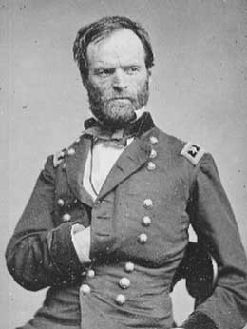

Slide 28
Appomattox Court House, VA
April 9, 1865
Leaders
North: Ulysses S. Grant
South: Robert E. Lee
Factors:
Grant is able to continuously attack Lee’s smaller armies and pushed them back to Petersburg, Virginia a major rail hub near the capital at Richmond
Significance:
After a 10 months siege, Richmond falls and Lee is forced to surrender 7 days later due to lack of resources

Slide 32
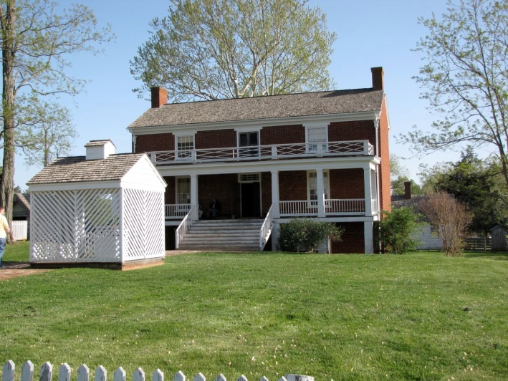

Slide 33
Lincoln | Kennedy
Lincoln was elected to Congress in 1846 | Kennedy was elected to Congress in 1946
He was elected President in 1860 | He was elected President in 1960
His wife lost a child while living in the White House | His wife lost a child while living in the White House
He was directly concerned with Civil Rights | He was directly concerned with Civil Rights
Lincoln had a secretary named Kennedy who told him not to go to the theater *1 | Kennedy had a secretary named Lincoln who told him not to go to Dallas *2
Lincoln was shot in the back of the head in the presence of his wife | Kennedy was shot in the back of the head in the presence of his wife
Lincoln shot in the Ford Theatre | Kennedy shot in a Lincoln, made by Ford
He was shot on a Friday | He was shot on a Friday
The assassin, John Wilkes Booth, was known by three names, comprised of fifteen letters | The assassin, Lee Harvey Oswald, was known by three names, comprised of fifteen letters
Booth shot Lincoln in a theater and fled to a warehouse *3 | Oswald shot Kennedy from a warehouse and fled to a theater
Booth was killed before being brought to trial | Oswald was killed before being brought to trial
There were theories that Booth was part of a greater conspiracy | There were theories that Oswald was part of a greater conspiracy
Lincoln's successor was Andrew Johnson, born in 1808 | Kennedy's successor was Lyndon Johnson, born in 1908

Slide 35
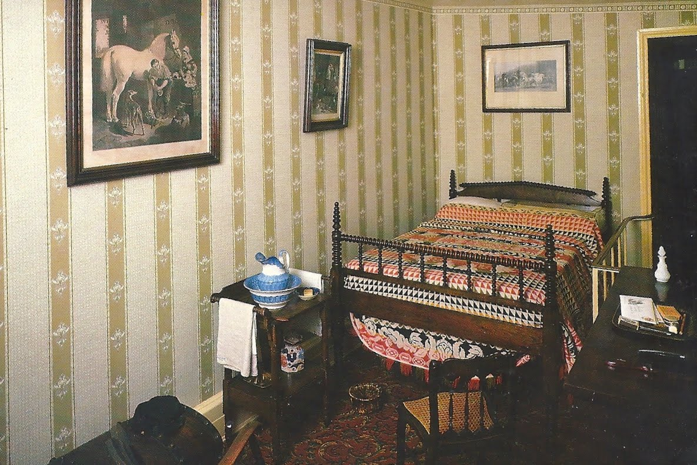

Slide 38
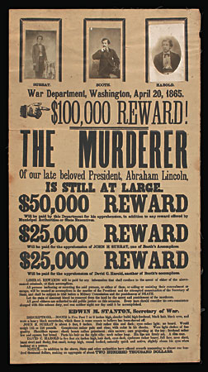

Slide 39
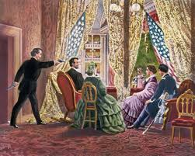
Lincoln Assassination
Lincoln is assassinated at Fords Theater by actor and Sothern sympathizer John Wilkes Booth
Lewis Paine (Powell) attacks Secretary of State William Seward
George Atzerodt plans but fails to attack vice president Andrew Johnson
Booth is killed 10 days later while attempting to escape in Maryland. The other conspirators are captured and put on trial.

Slide 40
Effects of the Civil War
Estimated 620,000 casualties
Mass destruction of southern cities and railroads
The nation will be reunited politically
Legislation begins to end slavery in the United States
First Presidential assassination in American history
Emotional effects will be felt between north and south for many years
New technologies developed
Massive economic growth especially in north
Growth of western expansion

