Slide 1
The Great Depression & The New Deal
1929 – 1930s

Slide 2
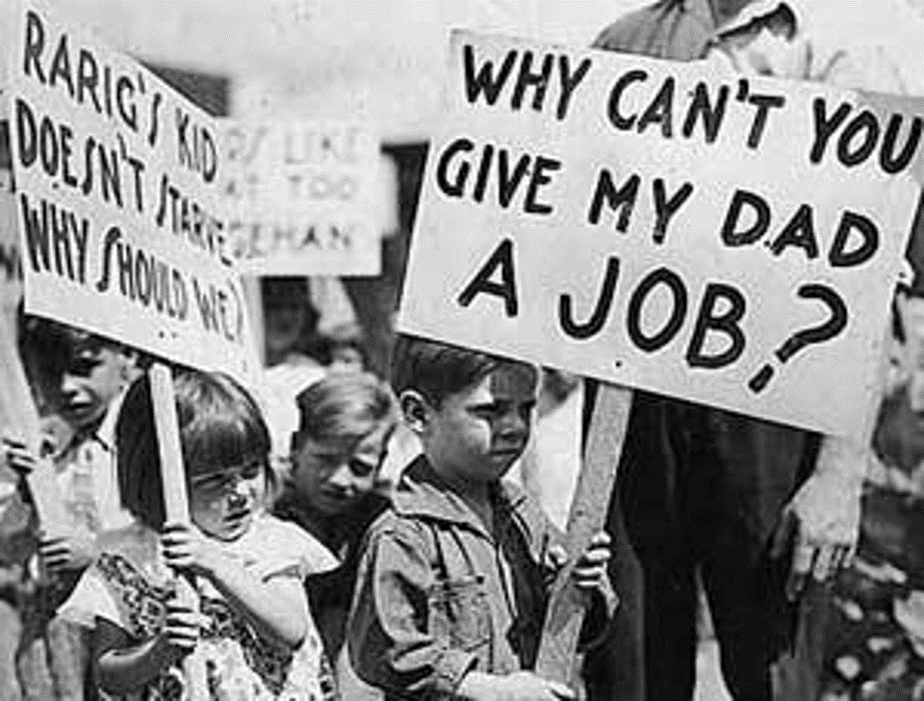
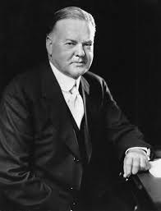
3 Major Causes:
1. Overproduction
2. Stock Market Crash
3. Banks
Who was President at the time?
HERBERT HOOVER
President 1929-1933

Slide 3
Overproduction
Oversupply led to lack of profits and company stocks began to drop
When company profits began to drop they started to lay off workers
Trickle down effect
Production rose 32% in the 1920’s due to ideas like the assembly line and mass production of the Ford Company

Slide 4
Stock Market
Bull Market: Long period in the 1920’s when stocks continued to rise
10% of Americans owned stock
Stocks could be purchased on margin or by credit
Stock Speculation occurred
In the late 1920’s the stock market started to slow down due to overproduction of companies
Investors stopped buying stocks when they stopped being profitable and started to sell them as prices began to drop
When stock prices fell, people could not pay back loans

Slide 5
STOCK MARKET CRASH
BLACK TUESDAY - October 29th, 1929
16 million shares were sold and the stock market lost 10 billion dollars
By November, 30 billion dollars had been lost
The stock market crashed
Big businesses went bankrupt
Average Americans lost their jobs

Slide 6
BANKS
How were banks involved?
In 1929, banks in the U.S. loaned over 6 billion dollars for stocks
Interest rates were very low in the 1920’s which caused banks to make risky loans
Because of the stock market crash, people began to default on their loans (couldn’t pay the interest)
Banks started to make less loans
This led to lack of credit for consumers to invest
Banks collapsed across the country!

Slide 7
BANKS
How do they work?
A bank is a business that makes money by lending money
Banks give loans (up front payments) in return for credit which is paid off with interest, meaning more than the original amount that was borrowed
Banks only have enough physical paper money for daily uses (transactions and deposits)
When the stock market crashed, people panicked and went to their banks to get their savings out… This is called a BANK RUN
10% of the banks closed in 1932

Slide 9
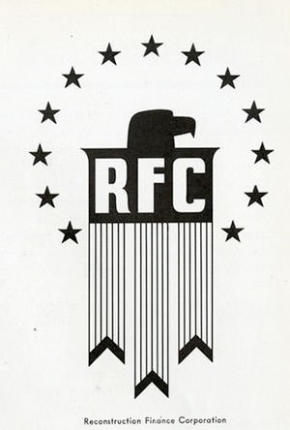
Hoover’s Ideas
President Hoover believed in “Rugged Individualism” -Americans should fix the economic trouble for themselves individually not through government charity
He held several conferences with the nations most wealthy business owners to try to promote recovery
Hoover asked the Federal Reserve to print more currency
HOW DID HOOVER TRY TO HELP? He created…
NCC – National Credit Corporation: provided a pool of money to which banks could use to start loans again
RFC – Reconstruction Finance Corporation: provided loans to big business - $238 million to railroads and banks
Emergency Relief and Construction Act: - $1.5 billion into public works projects

Slide 10
Bonus Army
Hoover’s Downfall
Congress enacted a $1,000 bonus to all WWI Veterans to be given in 1945
By 1932, many former servicemen lost their jobs and money due to the Depression, so they asked Congress to redeem their bonus early
A group of veterans started marching across the country and by the time they arrived in Washington, they had over 15,000 members called the Bonus Army
They built Hoovervilles on the national mall and petitioned the government for their bonuses
President Hoover refused to meet with them and eventually called in General Douglas MacArthur and General George Patton to use tanks, cavalry and gas to clear the protesters
This event and the economic downfall hurt his chances of reelection in 1932

Slide 11
Franklin D. Roosevelt (FDR)
Next President: 1933-1945
FDR acted immediately to restore public confidence, announcing a bank holiday and speaking directly to the public by radio broadcasts called fireside chats
During his first “Hundred Days” he created some of the most important programs and institutions of the New Deal
His New Deal programs and reforms redefined the role of the federal government in the lives of Americans

Slide 12
FDR
The New Deal
1. Bank Holidays (Emergency Banking Relief Act) - Closed and examined the nations banks and reopened them with a license from the treasury department
2. SEC (Securities Exchange Commission) - Regulated the stock market and prevented fraudulent buying practices (still around today)
3. Glass Steagall Act – Separated commercial and investment banks. Commercial bank could not invest in stocks
4. FDIC (Federal Deposited Insurance Corp) – Insured bank deposits to a certain amount ($250,000)
5. HOLC (Home Owner Loan Corp) – Restructured loans with longer payment periods and lower interest rates (only for employed)
6. FCA (Farmers Credit Administration) – Helped farmers refinance their mortgages

Slide 13
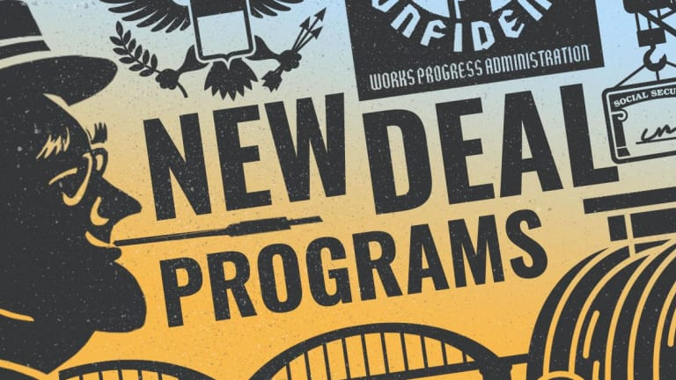
The First 100 Days
FDR
7. AAA (Agricultural Adjustment Act) - Government paid farmers to not grow certain crops to cause demand and prices to rise
8. TVA (Tennessee Valley Authority) - Government sponsored construction of dams, flood control and hydro electric plants to rural Appalachian areas (Tennessee and Kentucky)
9. NIRA (National Industrial Recovery Act) - Blue Eagle: Allowed companies to form trusts again also permitted workers to unionize. It was found to be unconstitutional in 1935
10. CCC (Civilian Conservations Corps) - Men age 18-25 gave jobs in work camps in the forestry industry provided $25 a month to families
11. PWA (Public Works Administration) – Built roads, schools, dams and sewers

Slide 14
12. CWA- (Civil Works Administration) – $1 billion spent in 5 months in construction of airports roads and schools (closed by Roosevelt to avoid spending)
13. WPA (Works Progress Administration) - Largest New Deal project
14. NLRB (National Labor Relations Board) - Wagner Act: Companies allowed workers to vote for union membership and allowed for third party arbitrators
15. Social Securities Act – Provided retirement benefits for citizens 65 and older directly from taxes also created an unemployment fund for displaced workers
What really helped the U.S. get out of the Great Depression?
WORLD WAR 2

Slide 15
