Slide 1
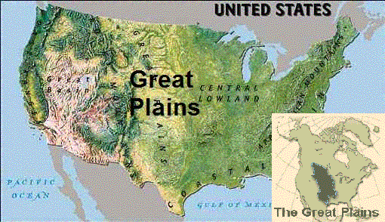
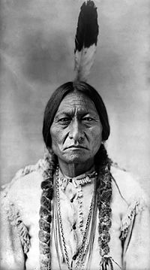
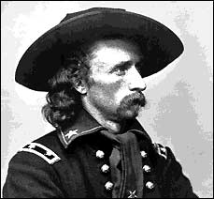
Plains Indian Wars

Slide 2
Reasons people moved west??

Slide 3
Reasons People Move West
Cheap land
Gold and minerals
To get away from post Civil War problems in the south
Jobs – mining, farming, cowboys, railroads
Government increase pop – 60,000 needed to go from territory – state.
Add new states
Complete Manifest Destiney

Slide 4
Challenges out West
Problems and Challenges??

Slide 5
Challenges
Native Americans
Crime – outlaws
Lack of good roads and transportation
Wilderness – basic necessities such as food, clothing shelter

Slide 15
Transcontinental R.R.
Pacific R.R. Act of 1862
Central Pacific
Union Pacific
Completed in Promontory Summit, Utah in 1869
Reduced transportation from 6 months – 1 week.

Slide 16
Done !

Slide 17
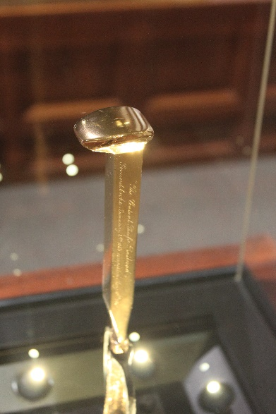

Slide 18
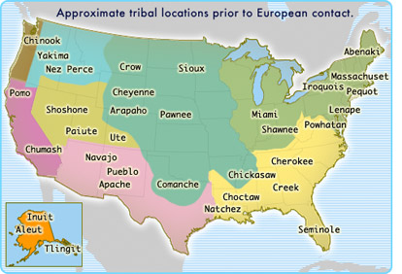

Slide 19
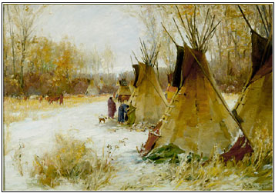
Tribes
Crow
Nez Perce Cheyenne Arapaho
Sioux
Lakota
Oglala
Hunkpapa
Teton
Miniconju

Slide 23
SIOUX Culture
Nomadic – groups called tiyospe …family groups that followed buffalo herds.
Each group was around 150 -300 . Around 4,000 Total
Barter system – no money units.
Verbal language only
Social structure – Oldest person in the tribe was viewed as a spiritual leader. The most courageous person was viewed as a military leader.
All Sioux men were required to be warriors and hunters and could decide where and when to fight.
Each warrior decided which leader to follow.
Sioux did not believe that humans could own land.
Belief in one God called the Great Spirit (Wakan Tanka)

Slide 24
Medicine Wheel
North – (Red) wisdom, place where the ancient ones passed over
South – (White) youth, friendships
East - (Yellow) beginnings, family
West – (Black) solitude, adulthood

Slide 25
Sioux Customs
Sweat Lodge – Purification
Ghost Dance – To ward away white settlers
Sun Dance – Vision of the future
Peace pipe was viewed as a method of prayer
Black Hills in South Dakota – viewed as sacred hunting lands
Buffalo was viewed as a sacred animal
Eagle was viewed as a sacred animal

Slide 26
Indian Peace Commission
1867
Congress proposed creating two large reservations on the plains one for the Sioux and one for all other tribes
The Peace Commission was a complete failure as poor conditions on the reservations lead Indians to leave.

Slide 27
Exit Slip Questions
1. Why do you feel American citizens of the time period have such a negative view point on Native Americans? (explain)
2. Who do you feel the land rightfully belonged to? Why?
3. If you were a Native American, what would you decide? Live on the reservations or become hostile? (Why?)
4. The treatment of the Native American tribes during the Plains Indian Wars is seen as very negative today. How could the government have handled this situation better?

Slide 28
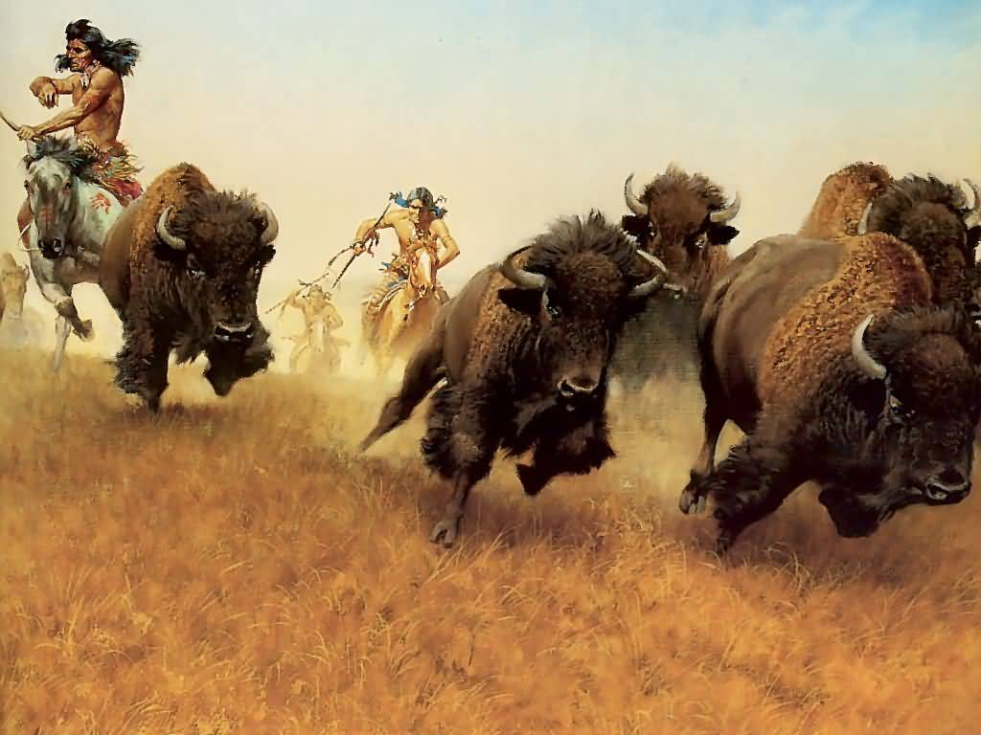
Hostile-Extermination
White settlers, with governmental support, continued to push Indians aside to take land, and they relied on the Army to prevent Indian attacks. At the same time, Native Americans on reservations had little chance of creating farms out of desolate pieces of land and were beset by poverty and desperation

Slide 30
Advantages and Disadvantages
Federal Army
Modern technology: guns, cannons and Gatling guns
Well organized chain of command
Railroads and telegraphs
Series of forts and trails
Support of people
Native Tribes
Strong will to defend homes and families
Extremely brave warriors
Tribes are small and not united
Weapons are outdated
Food supply under attack

Slide 32
Sand Creek Massacre -1864
Territory promised to Cheyenne in Colorado by Treaty
White settlers began to enter Cheyenne reservation lands when gold was found in Pikes Peak, Colorado
Cheyenne attacked gold mining town
Colonel John Chivington and the Army attached the Cheyenne Camp
Resulted in the death over 160 Native American Women and Children.

Slide 33
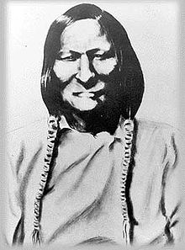
Black Kettle - Cheyenne
Col. John Chivington

Slide 35
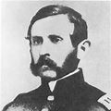
Red Clouds War and Fettermen Massacre
December 21, 1866
Location 4 miles north of Fort Phil Kearny, Wyoming
Result Indian victory
81 soldiers, 1,000 Native Americans
Casualties and losses
81 killed Soldiers
Probably about 13 Indians killed
Resulted in Fort Laramie Treaty - 1868

Slide 36
Captain William Fettermen - Idiot
Red Cloud – Lakota Sioux

Slide 38
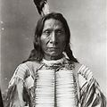

Slide 39
Battle of Washita River - 1868
United States Vs. Cheyenne
Commanders and leaders
George A. Custer Black Kettle
Strength 7th Cavalry Regiment
total camp population 250
Casualties 140+ men killed 75 women and children killed

Slide 40
Black Kettle
George A. Custer

Slide 42
Gold In the Black Hills
1874, gold was discovered in the Black Hills of the Dakotas and the Native American tribes were forced to leave reservation lands
Crazy Horse and Sitting Bull refused to move to another reservation and became “hostile”.
President Grant sent a 4 pronged Army attack including the famous George A. Custer to deal with the threat
The 7th Cavalry arrived at the Little Big Horn first and decided to attack the tribes prior to waiting for the other three reinforcement groups

Slide 43
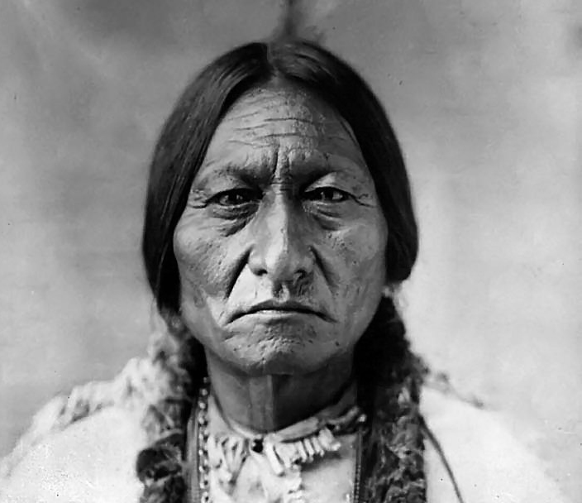
Sitting Bull
Crazy Horse ??

Slide 48
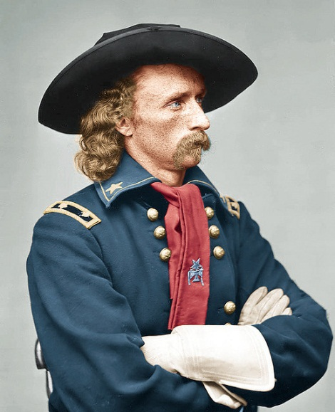
The Battle of Little Big Horn

Slide 49
Battle of the Little Big Horn
June 25, 1876
Native American camp was estimated at between 1500 and 2500 on the Little Big Horn River
The 7th cavalry had 678 troopers of which 258 including Custer and his command were killed
No survivors remained of the Custer fight
The nation was shocked and vowed revenge

Slide 50
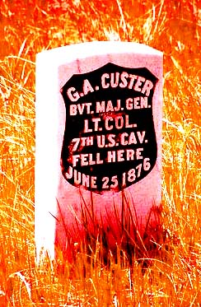

Slide 52
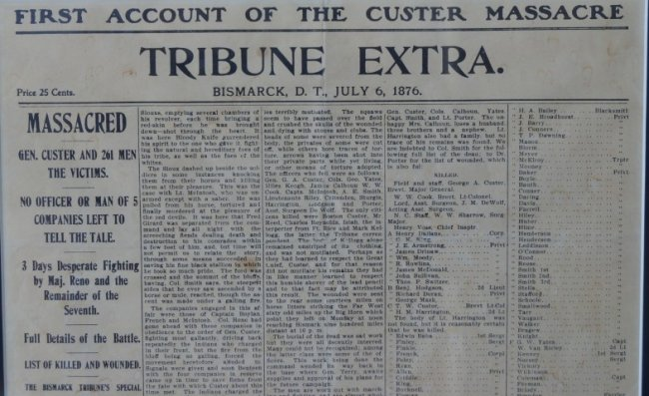

Slide 53
Wounded Knee
Dec, 1890
Considered the last major event to the Plains Indian Wars
Sioux Chief Bigfoot and 350 of his followers were performing ghost dance along reservation in Wounded Knee Creek, South Dakota
Reservation agents thought this was a violent uprising and called in the army
The army surrounded the Indian camp and forced the braves give up their weapons
The out break of violence occurred – between 150 -300 Native Americans killed
25 members of the 7th Cavalry killed

Slide 54
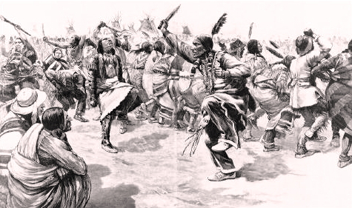

Slide 55
Dawes Act
1881 proposed by Congress (Senator Henry Dawes)
Would give 160 of reservation lands to individual Native Americans
After a 25 year period the Native Americans would be granted citizenship
Was a failure Native Americans proved to be poor farmers
It was not until 1924 that Native Americans were given citizenship
Disagreements over land still exist today

