Slide 1
World War I
Chapter 16

Slide 2
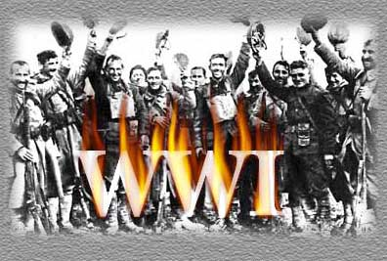
1st World War in history
Great War or War to End all War
Not called WWI until after WWII
Total war
Involved 60 nations and 6 continents

Slide 3
Long Term Causes of WWI
Four long-term causes of the WWI:
Militarism
Alliance System
Imperialism
Nationalism

Slide 4
Militarism
The belief in the power of strong armies or navies to decide issues.
It was thought that the only way to guarantee peace was to prepare for war.
Based on the idea that if a nation is strong, then no enemy would dare to attack it.
If war does break out, the militarized nation is able to defend itself.
This aggressive buildup of the militaries forced Britain into the alliance system

Slide 5
Alliances
Triple Entente-Allies is formed:
-between Britain, France, & Russia
Triple Alliance-Central Powers
-between Germany, Italy, & Austria-Hungry

Slide 6
CAUSES OF WORLD WAR I
Imperialism
France, Great Britain, Germany and Russia were establishing colonies in Africa and the Middle East, France and Germany were fighting over Morocco.
economic and political control over other countries……
these countries were in competition for colonies

Slide 7
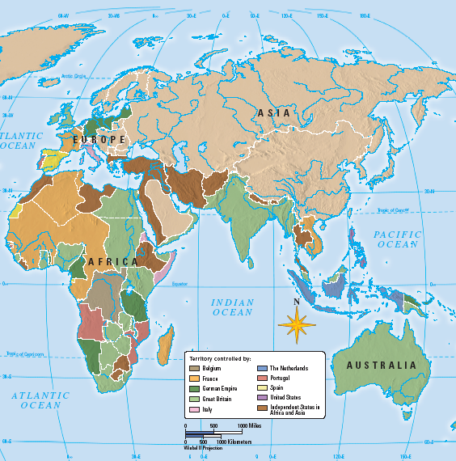
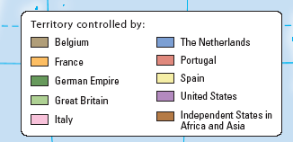
Cartoon-European grab bag
COLONIAL CLAIMS BY 1900

Slide 8
CAUSES OF WORLD WAR I
Nationalism
Countries proud of their heritage and culture
Similar to patriotism
Ethnic groups of similar heritage wanted to free their oppressed brethren and unite their people into one country
They wanted freedom and the right self-determination, to set up their own freely elected government.

Slide 9
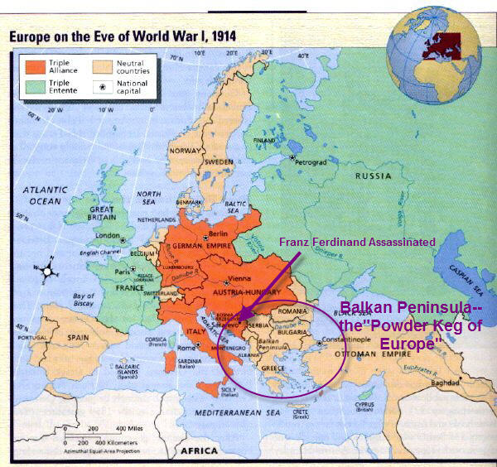
Powder Keg of Europe

Slide 10
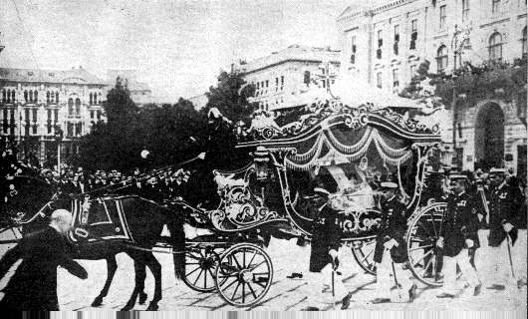
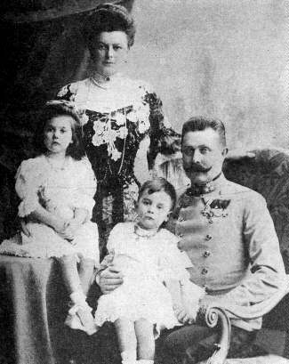
franz
ASSASSINATION OF FRANZ FERDINAND
Franz Ferdinand’s funeral procession
Archduke Franz Ferdinand and his family. Archduke was heir to the throne in the Austrian Hungarian Empire. His assassination June 28, 1914 eventually led to WWI.
Garvillo Princip, a Serbian nationalist assassinated the Archduke. He was trying to gain allowances for his fellow Serbs who lived under Austrian rule.

Slide 11
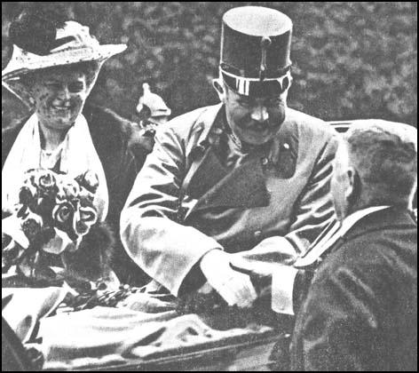
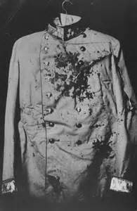
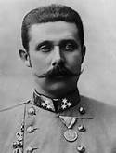
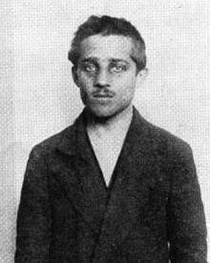
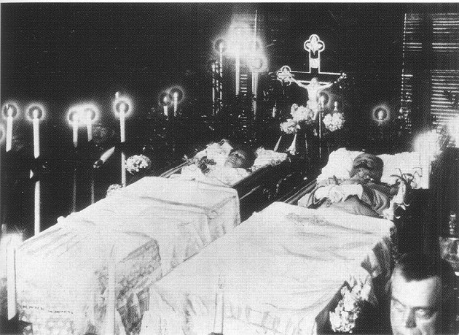

Slide 12
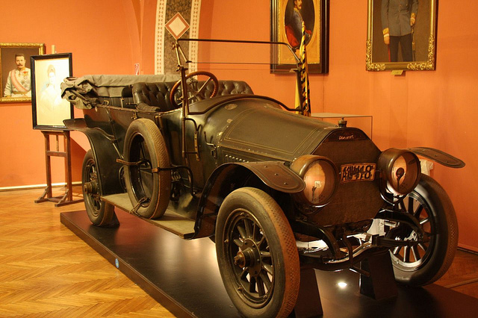

Slide 13
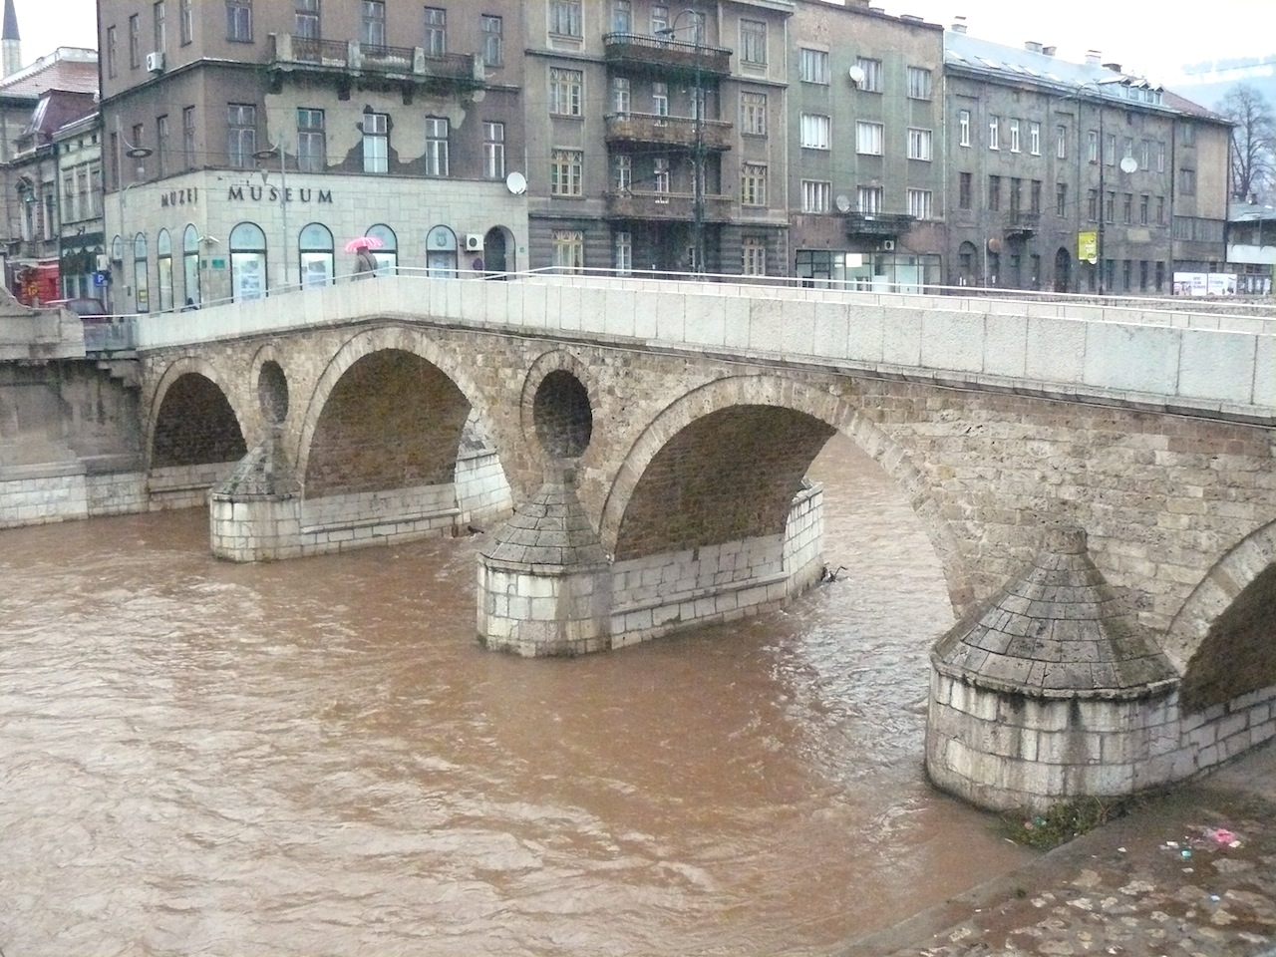
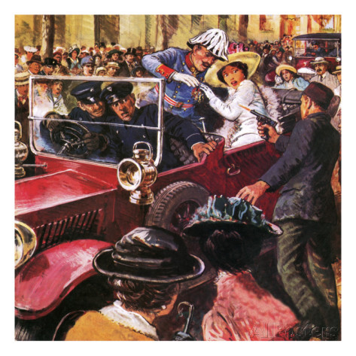

Slide 14
Alliance System
Allied Powers
Central Powers
Britain
Germany
France
alliances
Austrian-Hungarian Empire
Russia
Ottoman Empire
By 1914 two major alliances had formed

Slide 15
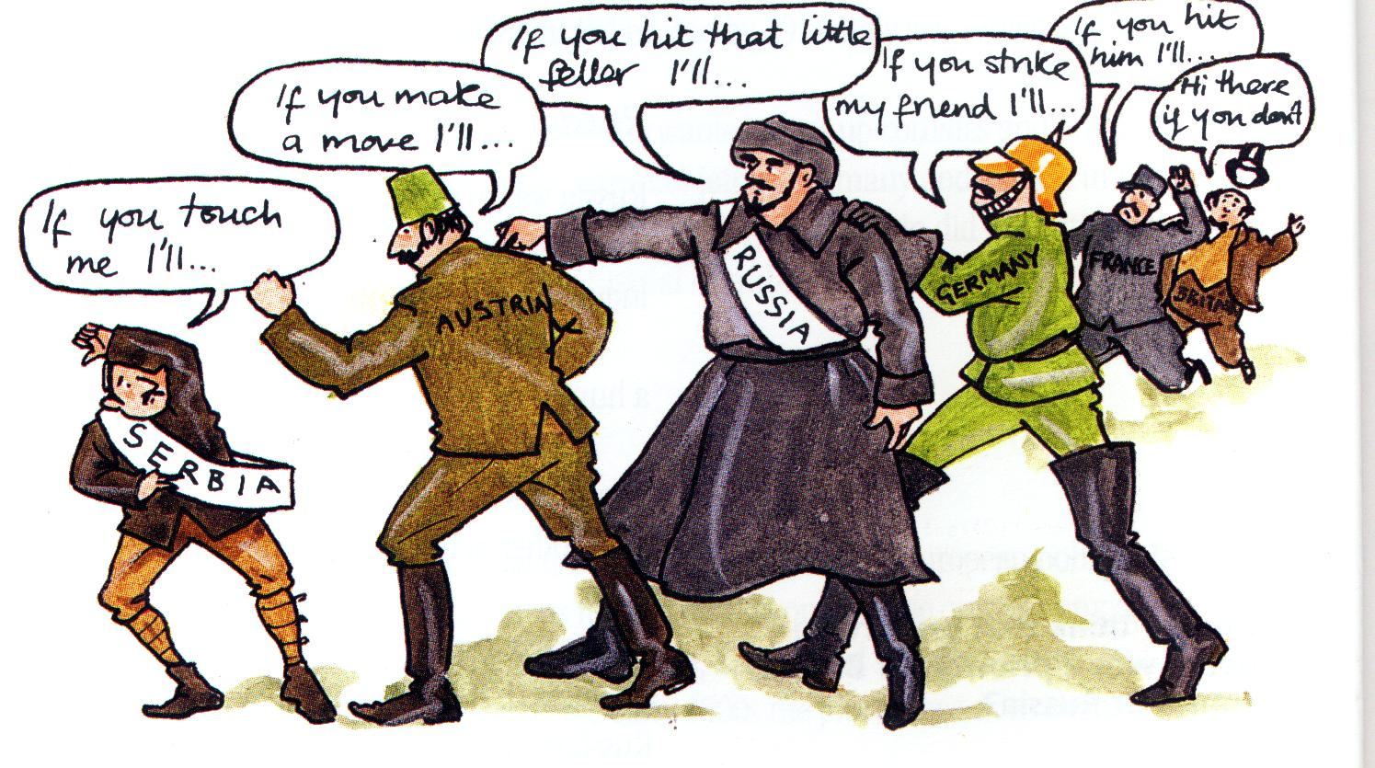

Slide 16
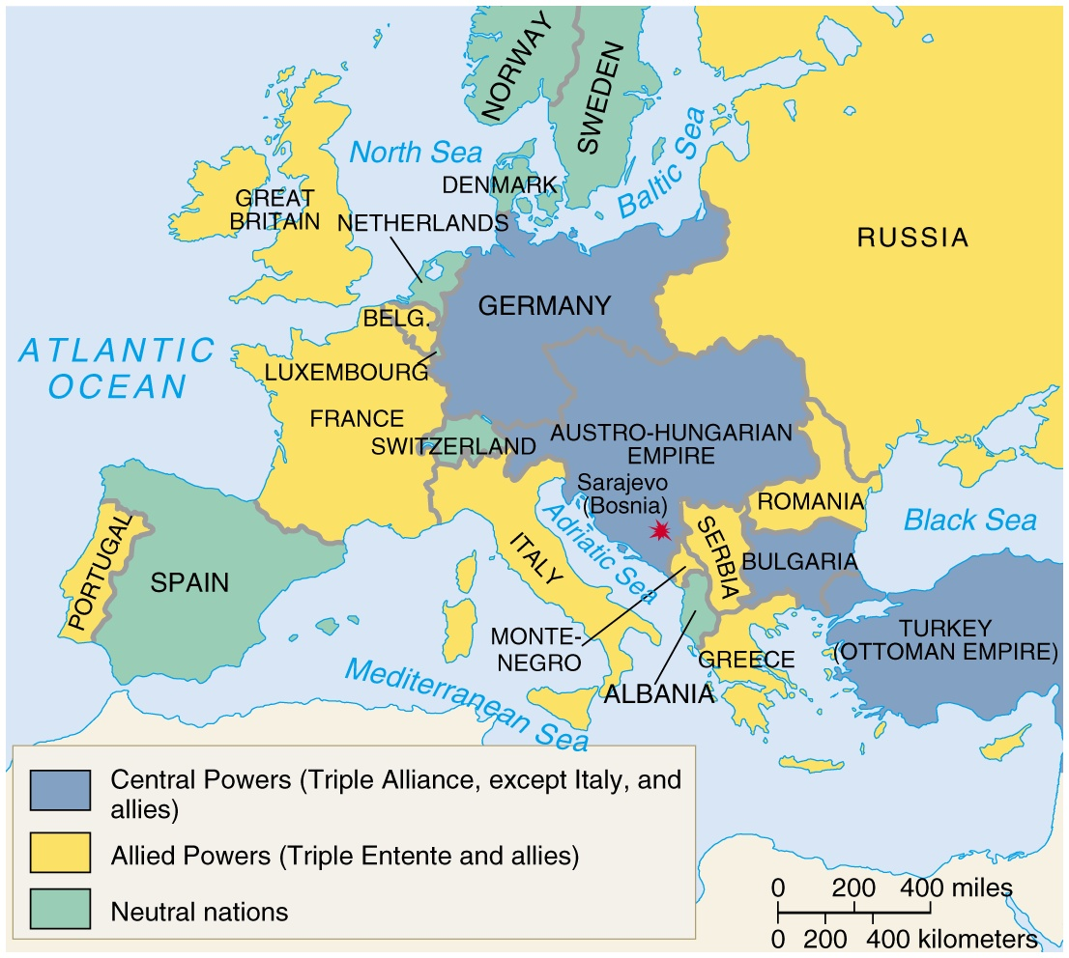
alliances1
ALLIANCES LEAD TO WWI
June 28 Assassination at Sarajevo
July 28 Austria-Hungary declared war on Serbia
July 30 Russia began mobilization
4. August 1 Germany declared war on Russia

Slide 17
alliances2
ALLIANCES LEAD TO WWI
August 3 Germany declared war on France
6. August 3 Great Britain declared war on Germany
August 6 Russia and Austria/Hungary at war.
August 12 Great Britain declared war on Austria/Hungary
Beginning of WWI in video

Slide 19
Which side should the US pick?
Central Powers:
Allies:
11 million German-Americans
Irish-Americans hated Great Britain
Close cultural ties
Shared transatlantic cables (so censored stories)
Big business loaned much $ to allies
US Exports to both sides:

Slide 20
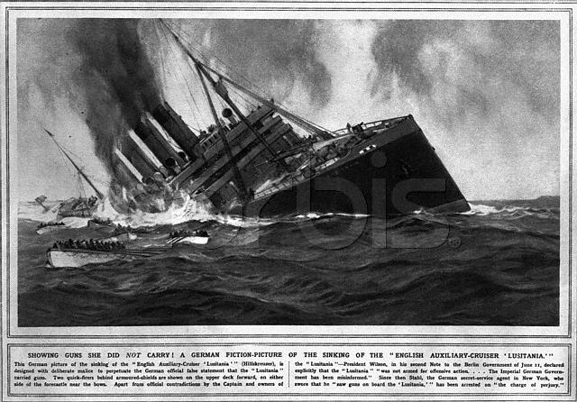
What did it take to get the US involved?
Blockades
Lusitania torpedoed, sinking with 1200 passengers and crew (including 128 Americans)
Was eventually found to be carrying 4200 cases of ammunition
German Propaganda Justifying Lusitania sinking

Slide 21
Lusitania
May 7th 1915 - British passenger ship Lusitania enters British waters
German U-boat sinks the ship killing almost all of the 1200 people on board-including 128 Americans
American were outraged
Another French ship called the Sussex was also sunk in 1916 killing 25 Americans.
Sussex Pledge signed by Germany who agreed not to sink any merchant ships without warning

Slide 22
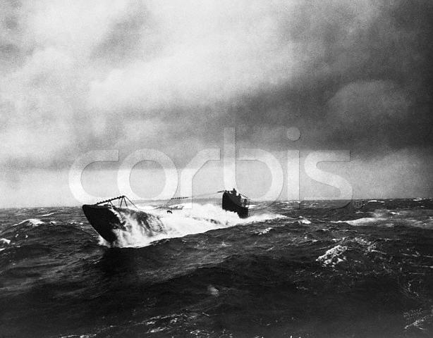
What did it take to get the US involved?
Unlimited Submarine Warfare
1917 Germany announced “unlimited submarine warfare” in the war zone
Why? Otherwise their blockade would not be successful

Slide 23
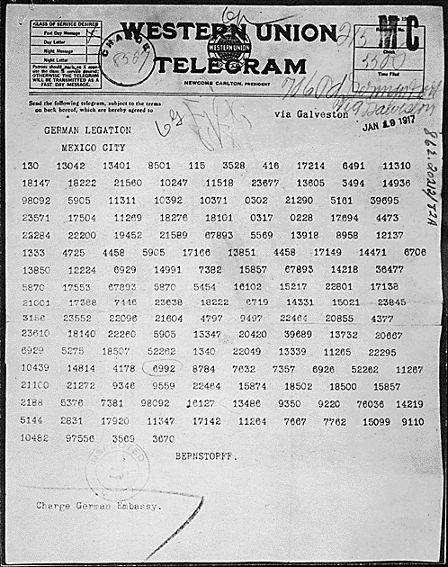
Zimmerman Note
German official Arthur Zimmerman sends a telegraph to Mexico asking Mexico to become an ally of Germany in a war with the U.S.
Germany promised Mexico would regain its lost territory of Texas, Arizona, & New Mexico after the war
Contents of note were leaked to American newspapers

Slide 24
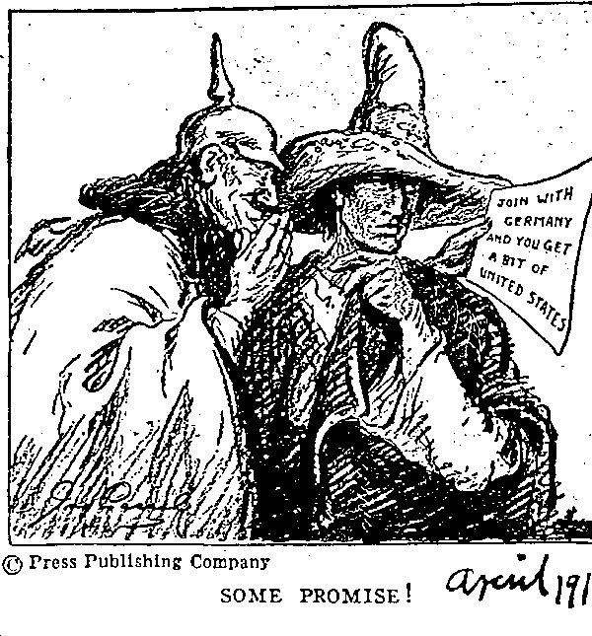
Cartoon about the Zimmerman telegram, March 1917
Notes:
Sauerkraut - freedom cabbage

Slide 25
Translation
"We intend to begin on the first of February unrestricted submarine warfare. We shall endeavor in spite of this to keep the United States of America neutral. In the event of this not succeeding, we make Mexico a proposal of alliance on the following basis: make war together, make peace together, generous financial support and an understanding on our part that Mexico is to reconquer the lost territory in Texas, New Mexico, and Arizona. The settlement in detail is left to you. You will inform the President of the above most secretly as soon as the outbreak of war with the United States of America is certain and add the suggestion that he should, on his own initiative, invite Japan to immediate adherence and at the same time mediate between Japan and ourselves. Please call the President's attention to the fact that the ruthless employment of our submarines now offers the prospect of compelling England in a few months to make peace." Signed, ZIMMERMANN

Slide 26
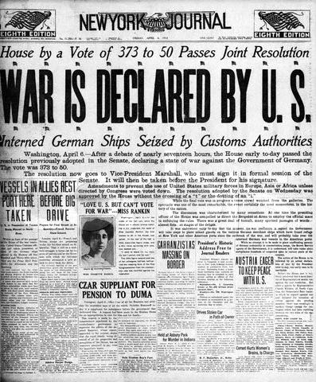
April 6, 1917 U.S Declares War

Slide 27
1917 – Selective Service Act
24,000,000 men registered for the draft by the end of 1918.
4,800,000 men served in WW1 (2,000,000 saw active combat).
400,000 African-Americans served in segregated units.
15,000 Native-Americans served as scouts, messengers, and snipers in non-segregated units.

Slide 28
Council of National Defense
War Industries Board – Bernard Baruch
Food Administration – Herbert Hoover
Railroad Administration – William McAdoo
National War Labor Board – W. H.Taft & Frank P. Walsh

Slide 29
Vocabulary Review
War Industries Board (coordinated war time production)
Victory Gardens (grow your own vegetables, conserve food for troops)
Committee on Public Information (goal was to “sell” the war to the public)
Espionage (spying to acquire government information)
Selective service (draft lottery drawn locally)

Slide 30
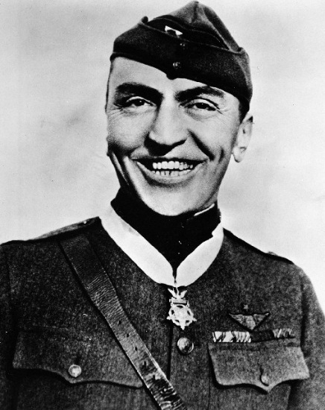
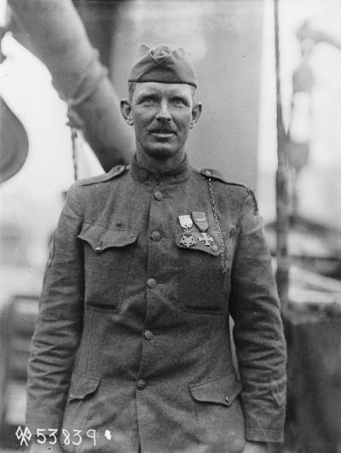
D. American Heroes
Alvin York – a poor country boy, initially against fighting, he joined the war b/c it was a just cause. He received the Medal of Honor and the French Croix de Guerre for amazing bravery at the Battle of the Argonne Forest.
Eddie Rickenbacker – a famous race cardriver, he was the top American pilot and once single-handedly fought seven German aircraft, for which he was awarded the Congressional Medal of Honor.

