Slide 1
New Technology and WWI Weapons
1914-1919

Slide 3
Effects of the Machine Gun
Would require a gun crew of four to six operators.
They could fire 400-600 small-caliber rounds per minute.
These early machine guns would rapidly overheat and become inoperative without the aid of cooling mechanisms.
The machine gun proved a fearsome defensive weapon. Enemy infantry assaults upon such positions invariably proved highly costly.

Slide 4
Tanks or Landship

Slide 5
Work in Progress
This first tank was given the nickname 'Little Willie' .
The tank could carry three people in cramped conditions.
Its top speed was three miles per hour on level ground, two miles per hour on rough terrain.
They often broke down and became ditched - i.e. stuck in a muddy trench.

Slide 6
Tanks produced during the war
France -4,700
United Kingdom – 2,800
USA- 84
Germany -20
Italy - 6

Slide 7
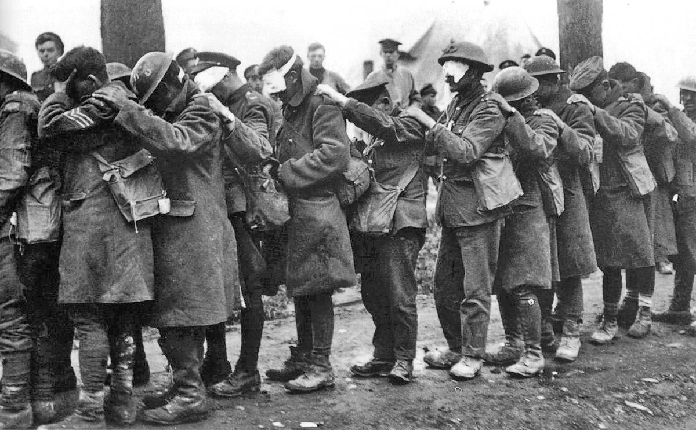
Poison Gas

Slide 8
Poison Gas
Chlorine, Mustard and Phosgene Gas
The effects of chlorine gas were severe. Within seconds of inhaling its vapor it destroyed the victim's respiratory organs, bringing on choking attacks.
The Germans' use of chlorine gas provoked immediate widespread condemnation, and certainly damaged German relations with the neutral powers, including the U.S.
After its initial effects in 1915, gas related deaths became relatively low due to better created gas masks.
1925 the use of gas in warfare became outlawed.

Slide 9
Planes

Slide 10
WWI Aviation -Dog Fights
1914 - In the first few months of the war, combat between airplanes was unknown; they were used for reconnaissance photographs.
1915 - Germans, installed interrupter gear, permitting a machine gun to fire through the propeller with much more reliability.
Pilots had not parachutes and carried pistols in case of fire or emergencies.
1917 -Average life expectancy for pilots was 3 weeks.

Slide 11
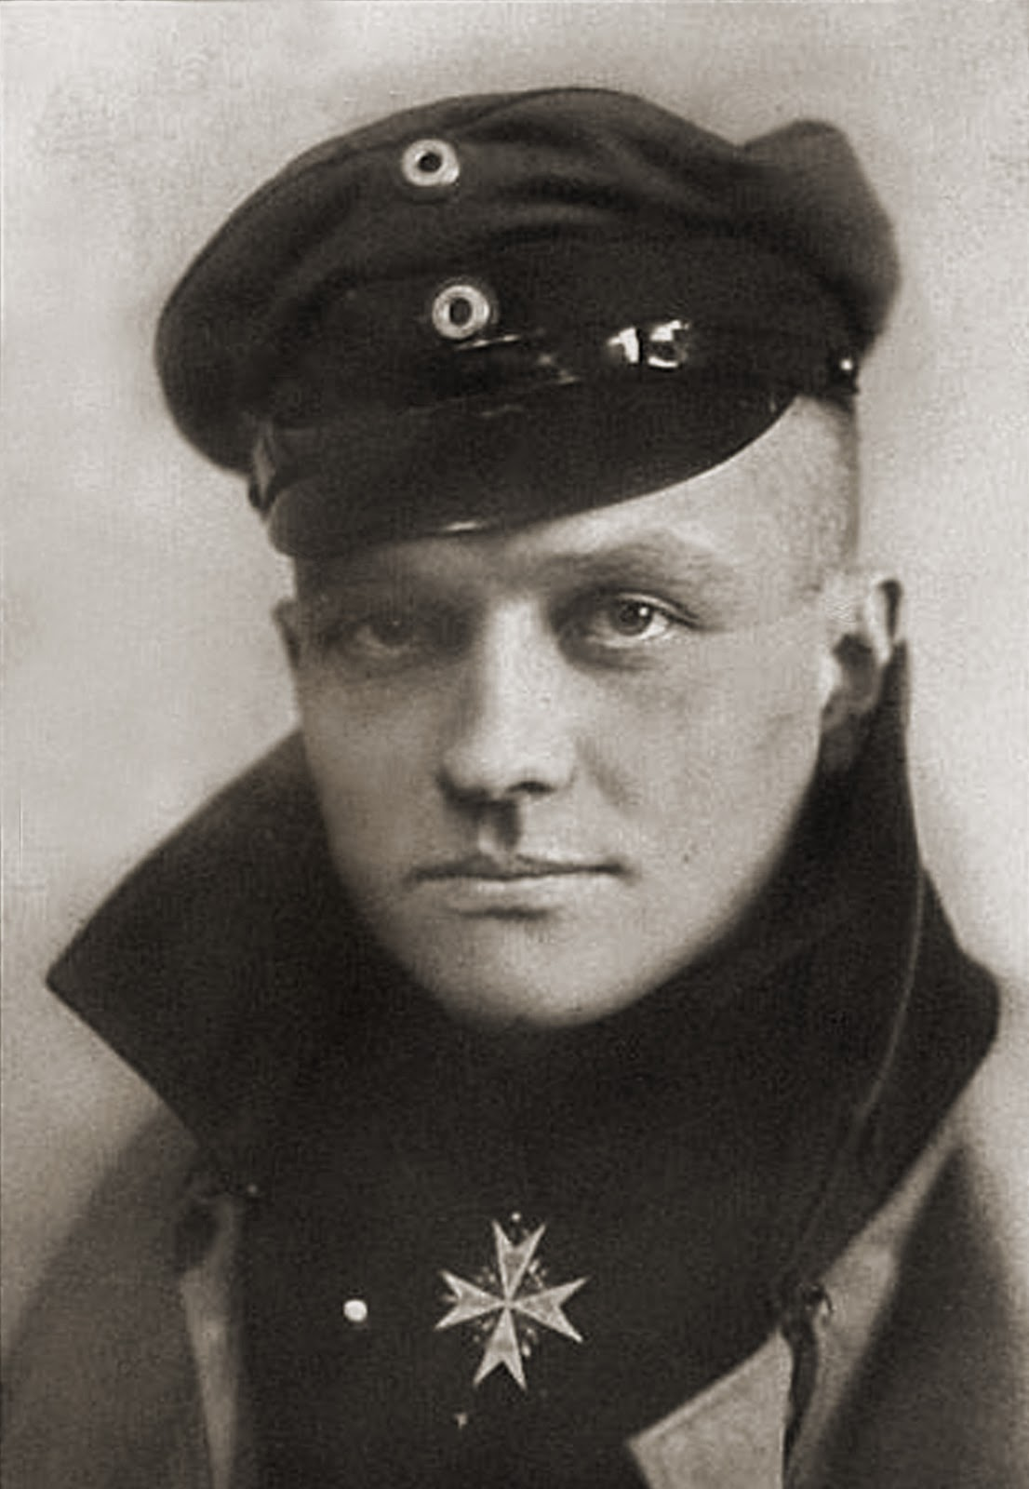
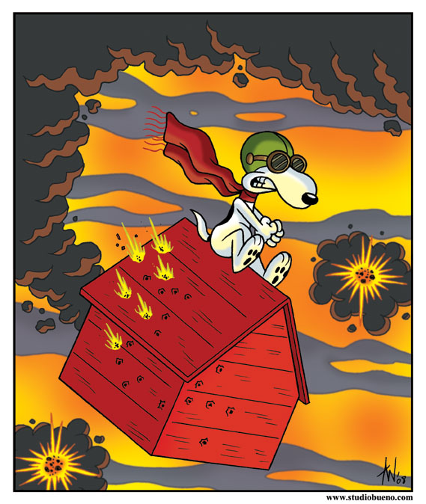
The Red Baron - Manfred von Richthofen
He is considered the top ace of that war, being officially credited with 80 air combat victories.
Notes:
Manfred Albrecht Freiherr von Richthofen
He is considered the top ace of that war, being officially credited with 80 air combat victories.
Richthofen was shot down and killed near Amiens on 21 April 1918. There has been considerable discussion and debate regarding aspects of his career, especially the circumstances of his death

Slide 12
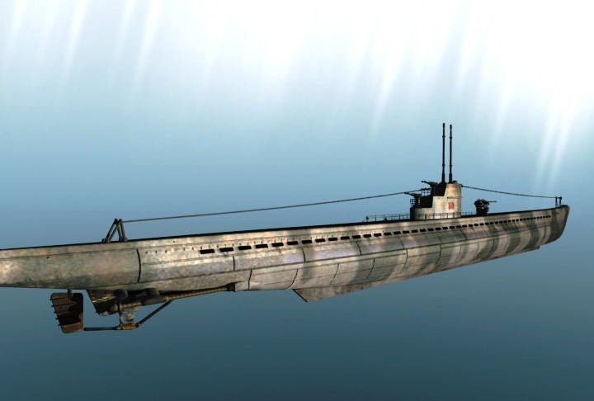
Other New Innovations
British and German Naval Race
British Destroyer
German U-Boat

Slide 13
Other New Innovations

Slide 14
Other New Innovations
Notes:
43 tons could fire up to 8 miles

Slide 15
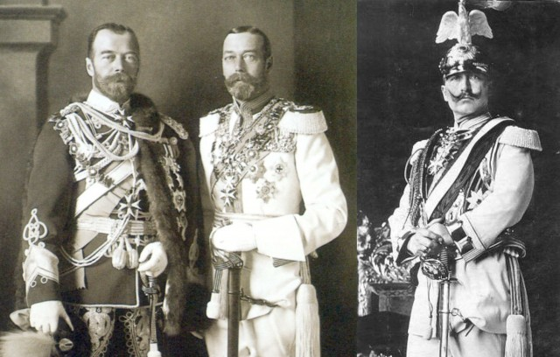
Leaders of WWI

Slide 16
United States
President Woodrow Wilson Posing with King George V: Despite his campaign pledge to keep the United States out of World War I, President Wilson asked Congress for a declaration of war in April 1917. Within months, massive numbers of American troops swelled the Allied ranks. More than 400,000 would see combat and 116,516 would die in the Great War.

Slide 17
United States
General John J. Pershing: A graduate of West Point and a veteran of the Battle of San Juan Hill, "Black Jack" Pershing was named commander of the American Expeditionary Force when the United States entered World War I in April 1917

Slide 18
Germany
Kaiser Wilhelm II: A fierce militarist, Wilhelm II encouraged aggressive Austro-Hungarian diplomatic policies following the assasination of Franz Ferdinand. The Kaiser was nominally in charge of the German army, but the real power lay with his generals. As World War I drew to a close, he was forced to abdicate in 1918

Slide 19
Germany
Paul Von Hindenburg: Von Hindenburg was recalled to service at the outbreak of World War I. By 1916, he and Erich von Ludendorff had assumed near total control of the German war effort, which they led until defeat in 1918. He later served as German president, and named Adolf Hitler chancellor of Germany in 1933

Slide 20
Russia
Tsar Nicholas II: When Austria-Hungary declared war on Serbia, Russia's alliance with its Balkan neighbor forced it to enter the war against the Central Powers. The tsar assumed control of the Russian army, with disastrous results. In 1917, he was forced to abdicate, and he and his family were executed in 1918

Slide 21
Soviet Union
Vladmir Lenin: After the Bolsheviks seized power during the Russian Revolution of 1917, Lenin negotiated the Treaty of Brest-Litovsk. The treaty ended Russia's involvement in World War I, but on humiliating terms: Russia lost territory and nearly one-quarter of its population to the Central Powers

Slide 23
End of Romanov Dynasty

Slide 24
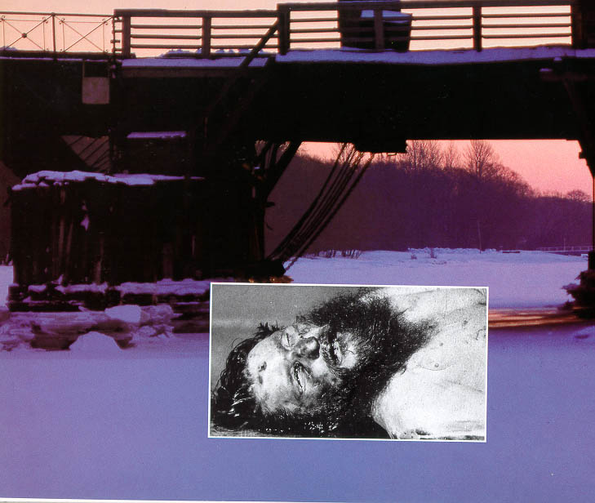
Gregory Rasputin

Slide 25
France
Georges Clemenceau : As prime minister of France from 1917 to 1920, Clemenceau worked to restore French morale and concentrate Allied military forces under Ferdinand Foch. He led the French delegation to the peace talks ending World War I, during which he insisted on harsh reparation payments and German disarmament

Slide 26
Britain
David Lloyd George, 1st Earl Lloyd George of Dwyfor January 1863 – 26 March 1945), was a BritishLiberal politician and statesman. He was Prime Minister of the United Kingdom and led a Wartime Coalition Government between 1916 and 1922 and was the Leader of the Liberal Party from 1926 to 1931

