Slide 1
Innovations Lead to Trench Warfare

Slide 5
Life in the Trenches
It has been estimated that up to one third of Allied casualties on the Western Front were actually sustained in the trenches.
Rats in their millions infested trenches.
Lice caused Trench Fever, a particularly painful disease that began suddenly with severe pain followed by high fever.
Overflowing latrines would similarly give off a most offensive stench.

Slide 6
WWI Casualties

Slide 7
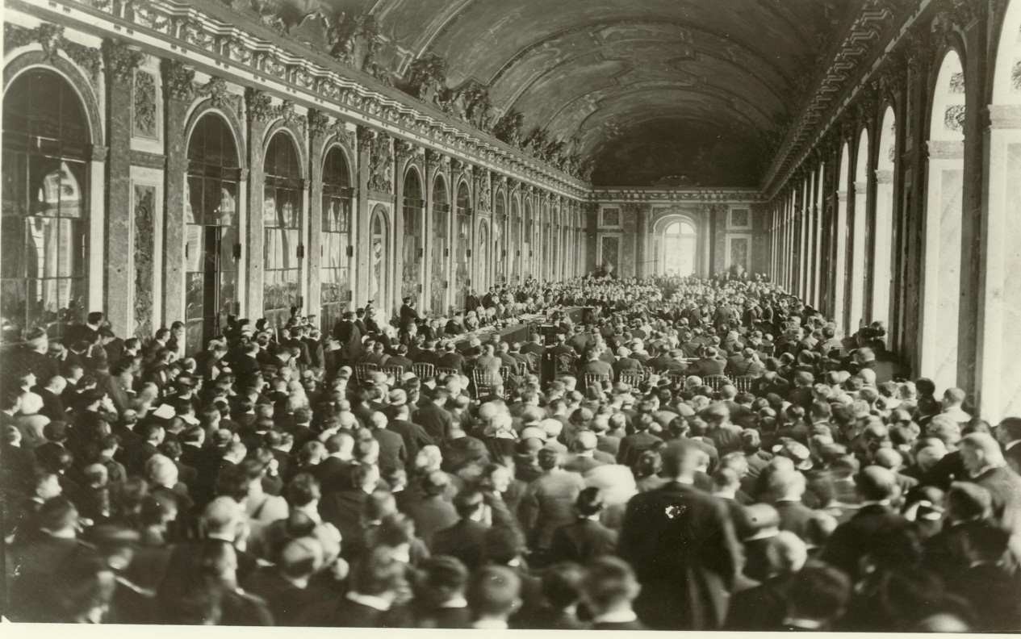
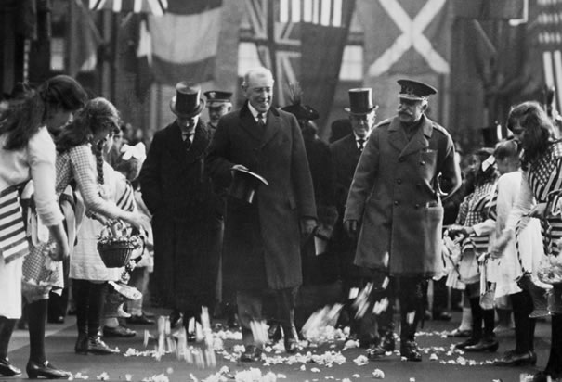
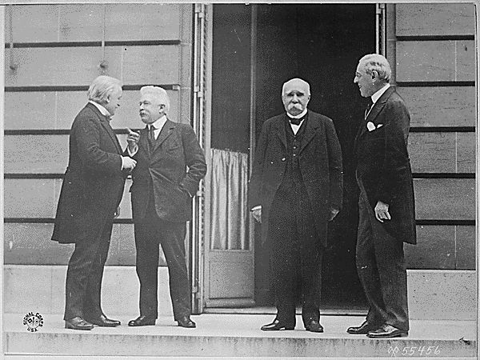

Slide 9
Woodrow Wilson’s Fourteen Points
1. Wilson had devised a 14 point plan that he believed would bring stability to Europe.
2. There were to be no secret treaties between powers like the treaties that had helped to cause the First World War. (Open Diplomacy)
3. Seas should be free in peace and in war to ships of all nations (Freedom of Navigation)
4.The barriers to trade between countries such as custom duties should be removed (free trade)
5.All countries should reduce their armed forces to the lowest possible levels (Multilateral disarmament.)
6.The national groups in Europe should, wherever possible, be given their independence. Wilson supported the idea of National Self-Determination, whereby a nation had the right to self-government.
7.Russia should be allowed to operate whatever government it wanted.
8.Territorial changes:
9.Germany should give up Alsace-Lorraine and any lands taken away during the war. 10. The Italian frontier should be readjusted. 11. Belgium should be evacuated. 12. Poland should be given an outlet to the sea.
13.The defeated nations should not be made to pay for the war as a whole.
14. A ‘League of Nations’ should be formed to protect world peace in the future.

Slide 14
League of Nations

