Slide 1
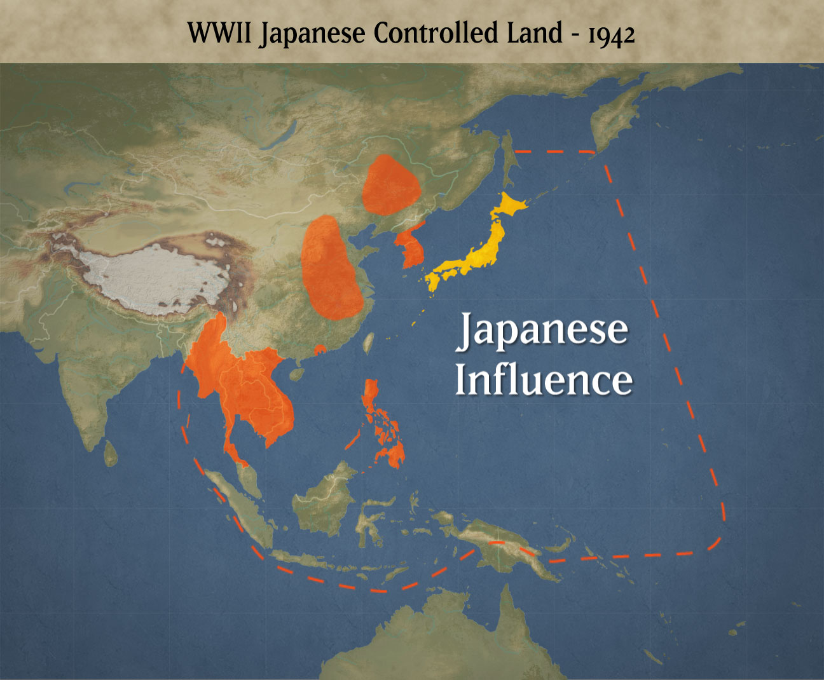

Slide 2
Imperial Japan
U.S. concerned about Japan’s expansion in the Pacific
To stop Japanese aggression in the Pacific FDR imposes economic embargos on strategic materials i.e. steel, scrap iron, oil, airplane fuel, etc.
Japanese signed pact with Germany & Italy

Slide 3
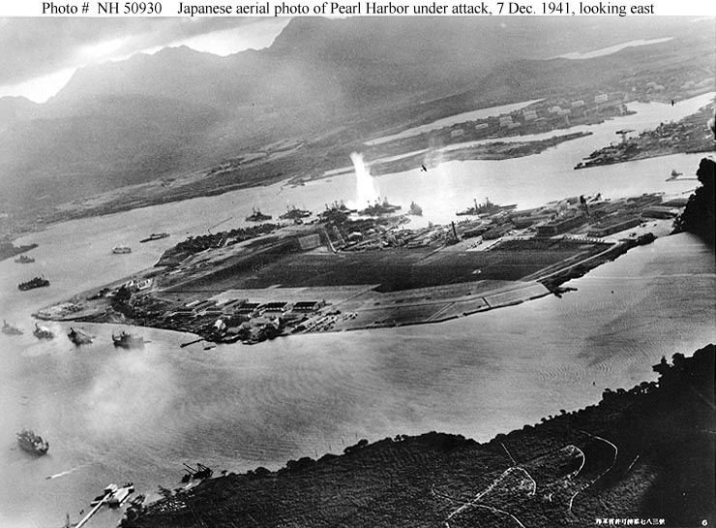

Slide 4
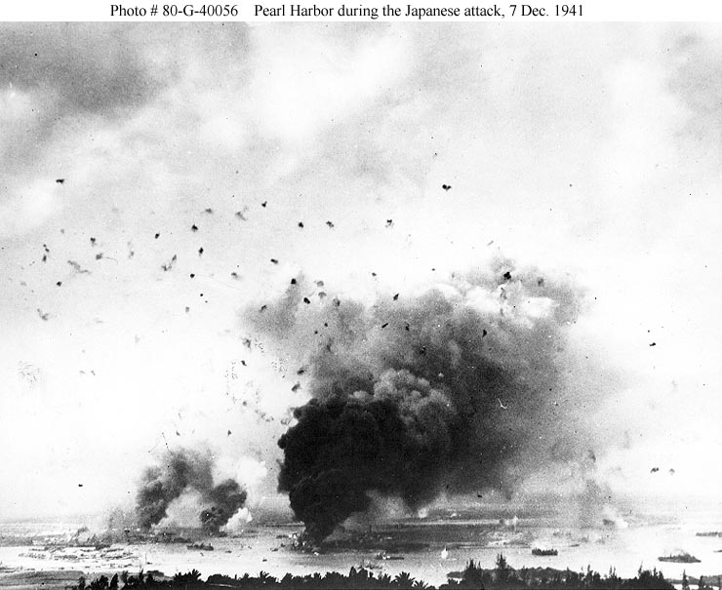
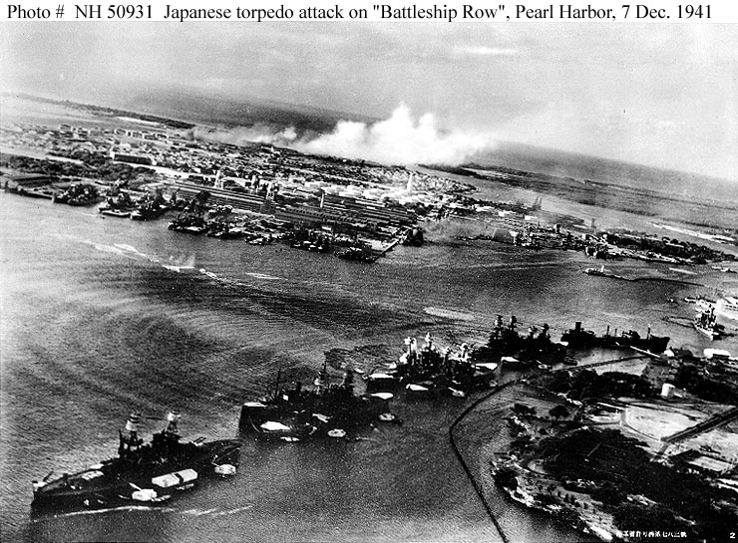

Slide 5
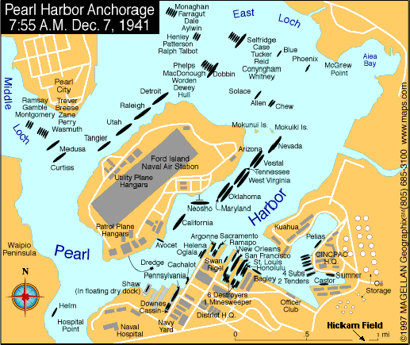

Slide 6
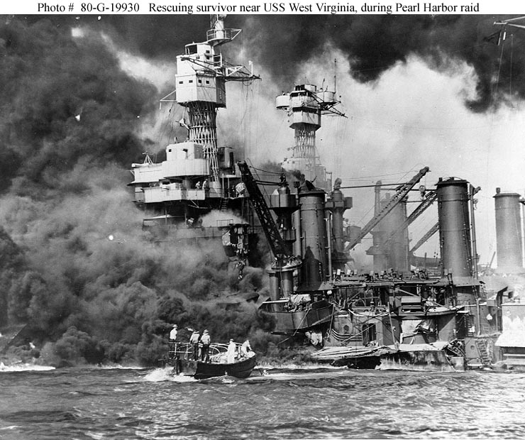

Slide 7
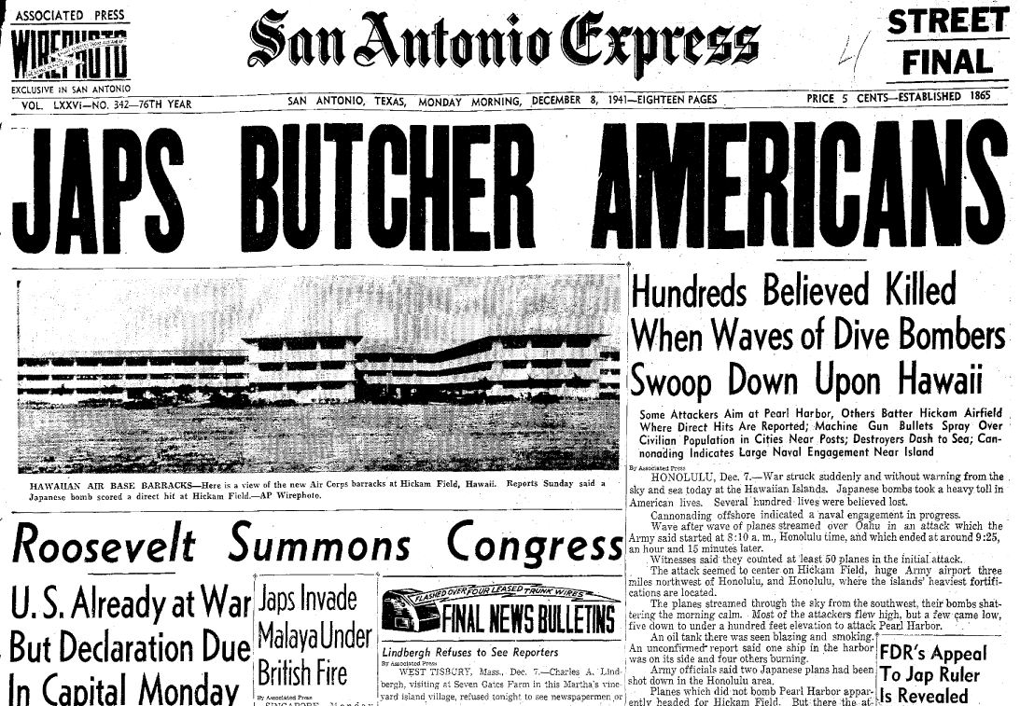

Slide 8
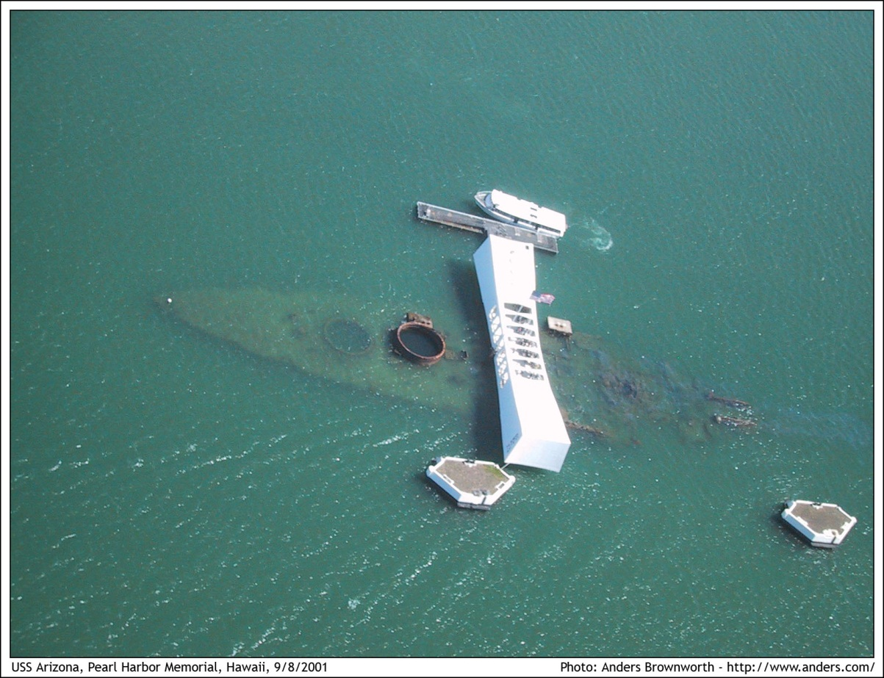

Slide 9
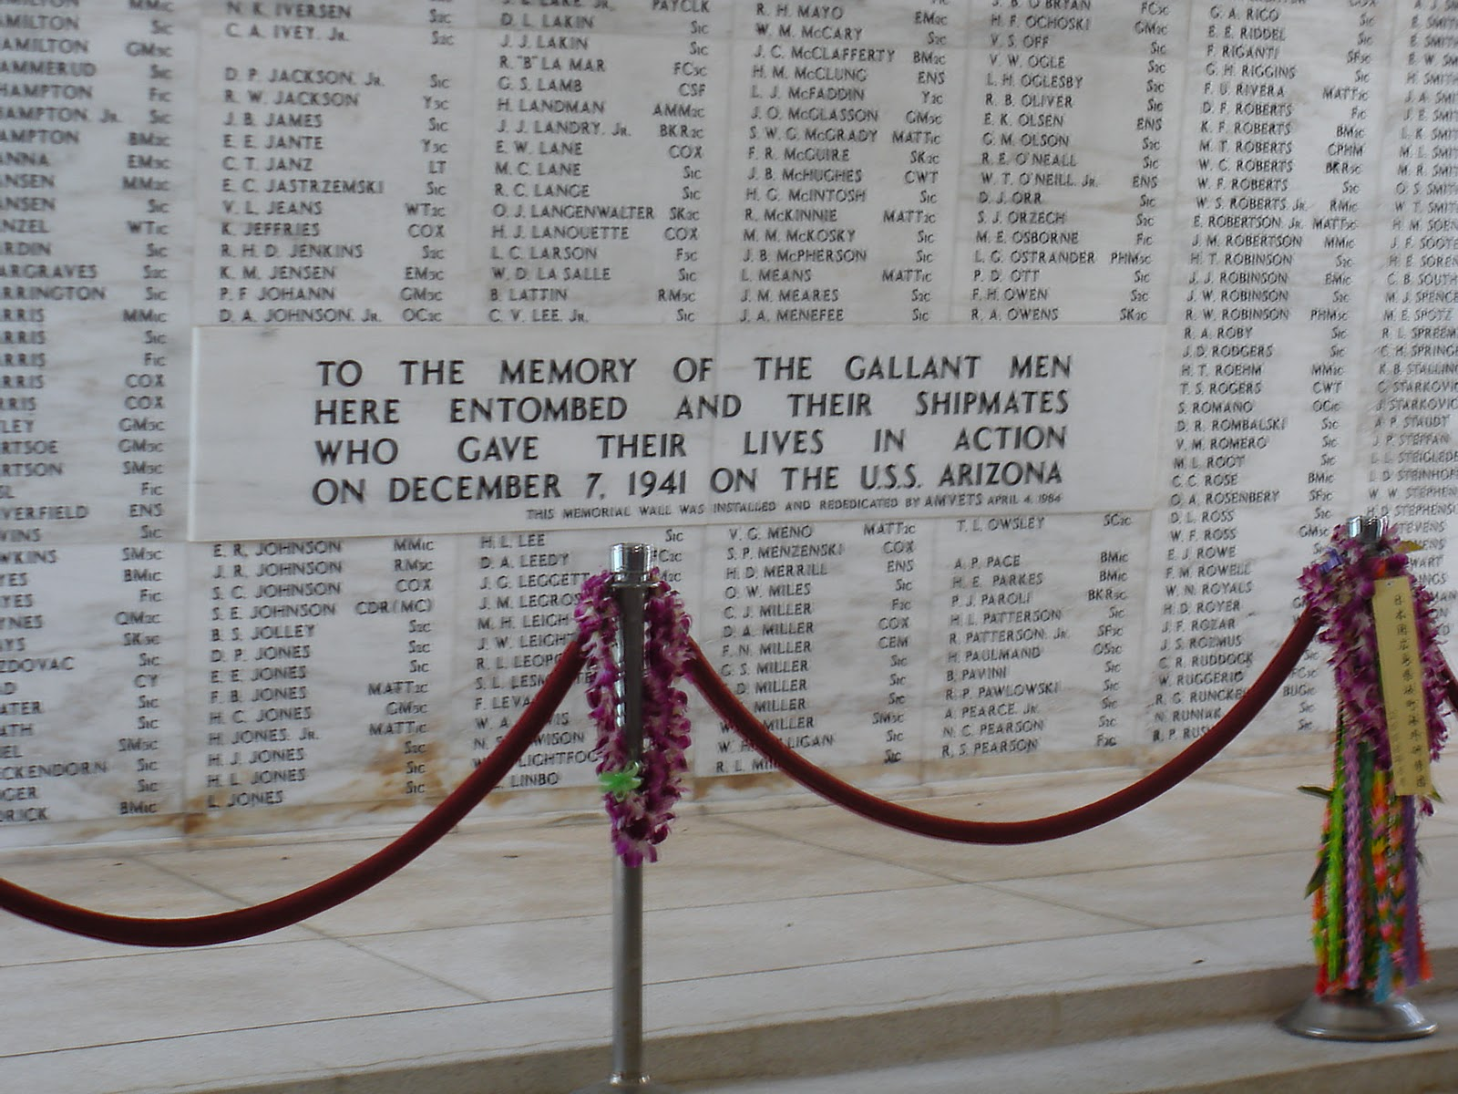

Slide 10
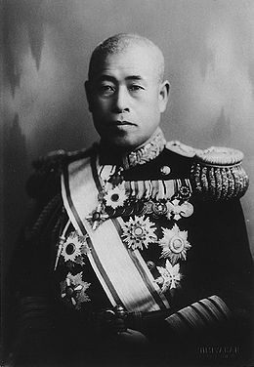
Admiral
Isoroku Yamamoto
“I fear all we have done is to awaken a sleeping giant and fill him with a terrible resolve.”

Slide 11
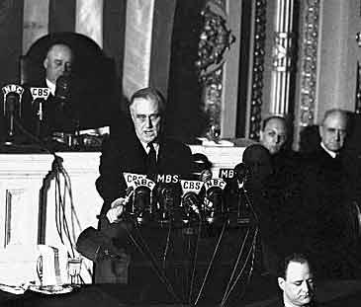
“Yesterday, December 7, 1941- a day that will live in infamy-the United States of America was suddenly and deliberately attacked by naval and air forces of the Empire of Japan…No matter how long it may take us…the American people in their righteous might will win through to absolute victory”
FDR

Slide 12

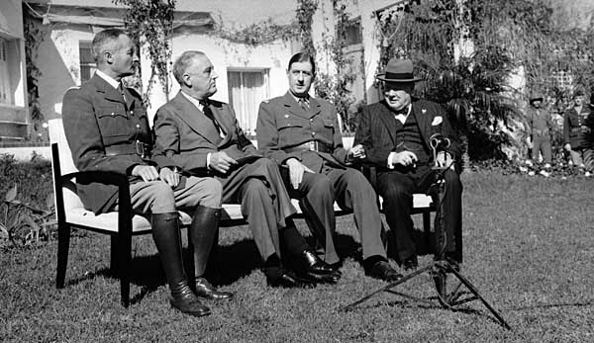
Sides are Drawn
Allies
United States
Britain
France
From left: Gen. Henry
Giraud of France, FDR, DeGaulle, &
Churchill

Slide 13
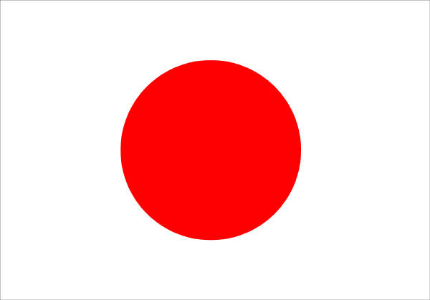
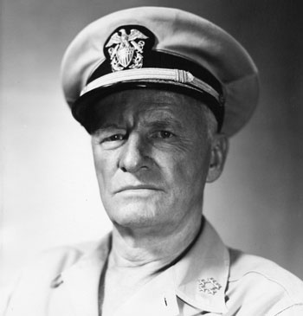
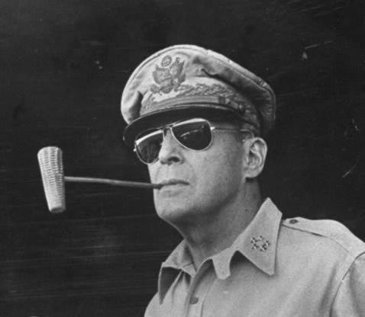
U.S. Navy
Admiral Chester Nimitz
General Douglas McArthur
Imperial Japan
Admiral Isoroku Yamamato

Slide 14
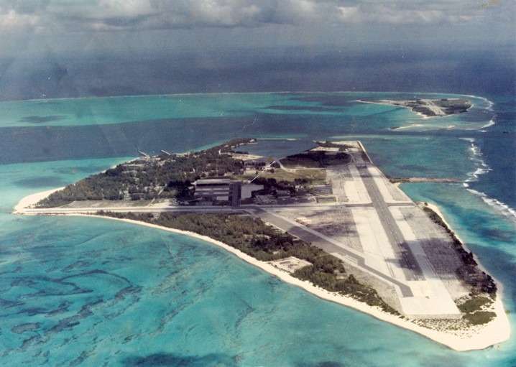
Midway Island

Slide 15
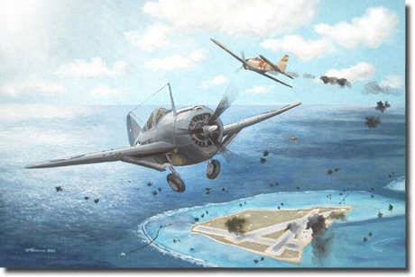

Slide 16
Battle of Midway Island
Casualties and losses
United States
1 carrier sunk –U.S.S. Yorktown
1 destroyer sunk
150 aircraft destroyed
307 killed[
Japan
4 carriers sunk: Akagi, Kaga, Hiryu and Soryu
1 cruiser sunk
248 carrier aircraft destroyed
3,057 killed

Slide 17
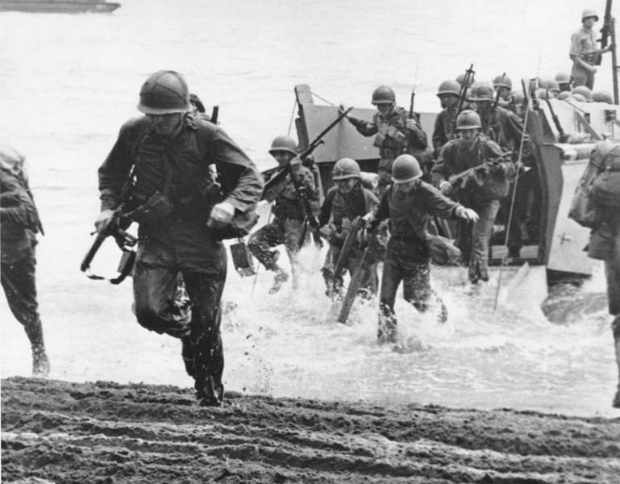

Slide 18
Battle of Guadalcanal
Aug 1942-Feb 1943 (6 months)
Casualties and Loses
UNITED STATES
7,100 dead
4 captured
29 ships lost
615 aircraft lost
Japan
31,000 dead
1,000 captured
38 ships lost
683–880 aircraft lost

Slide 19
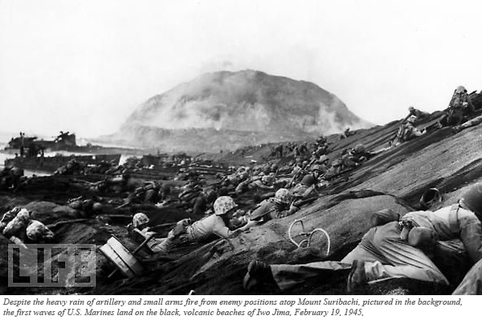

Slide 20
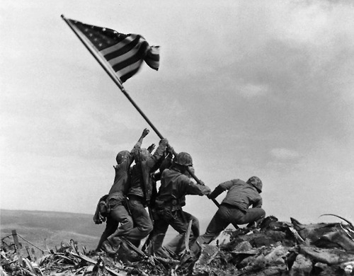

Slide 21
Battle of Iwo Jima
19 Feb -26 March 1945
Casualties and losses
United States
6,821 killed
2 captured but recovered
19,217 wounded
Japan
21,844 killed
216 prisoners

Slide 22
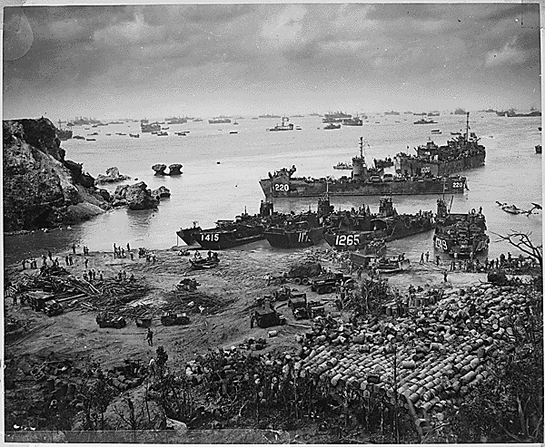

Slide 23
Battle of Okinawa
April –June 1945
United States
12,513 killed
38,916 wounded,
33,096 non-combat losses
Total: 84,570
Japan
About 95,000+ killed
7,400–10,755 captured
Total: 105,755+
Estimated 42,000–150,000 civilians killed

Slide 24
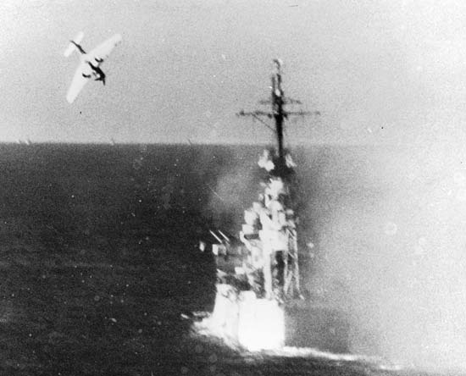
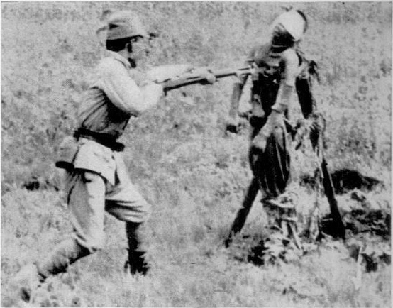
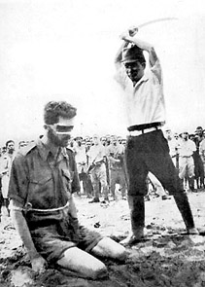
Pacific War Total
Japan
1,740,000
United States
111,606

Slide 25
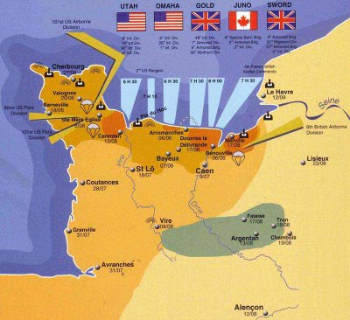
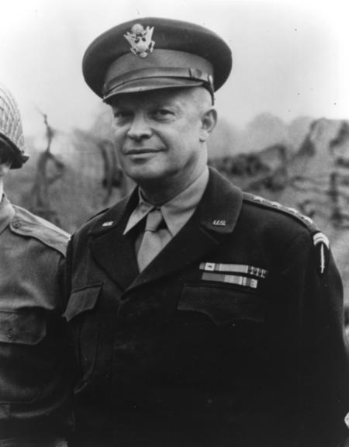

Slide 26
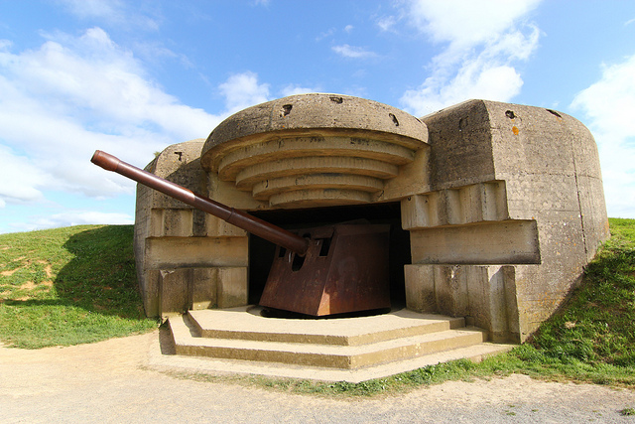
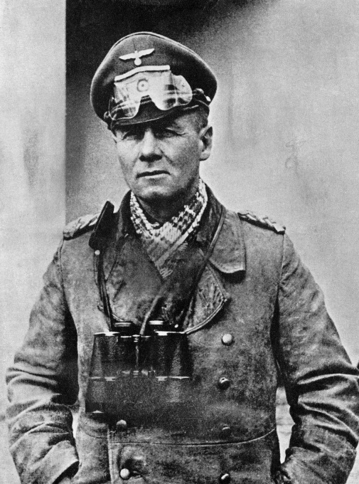

Slide 27
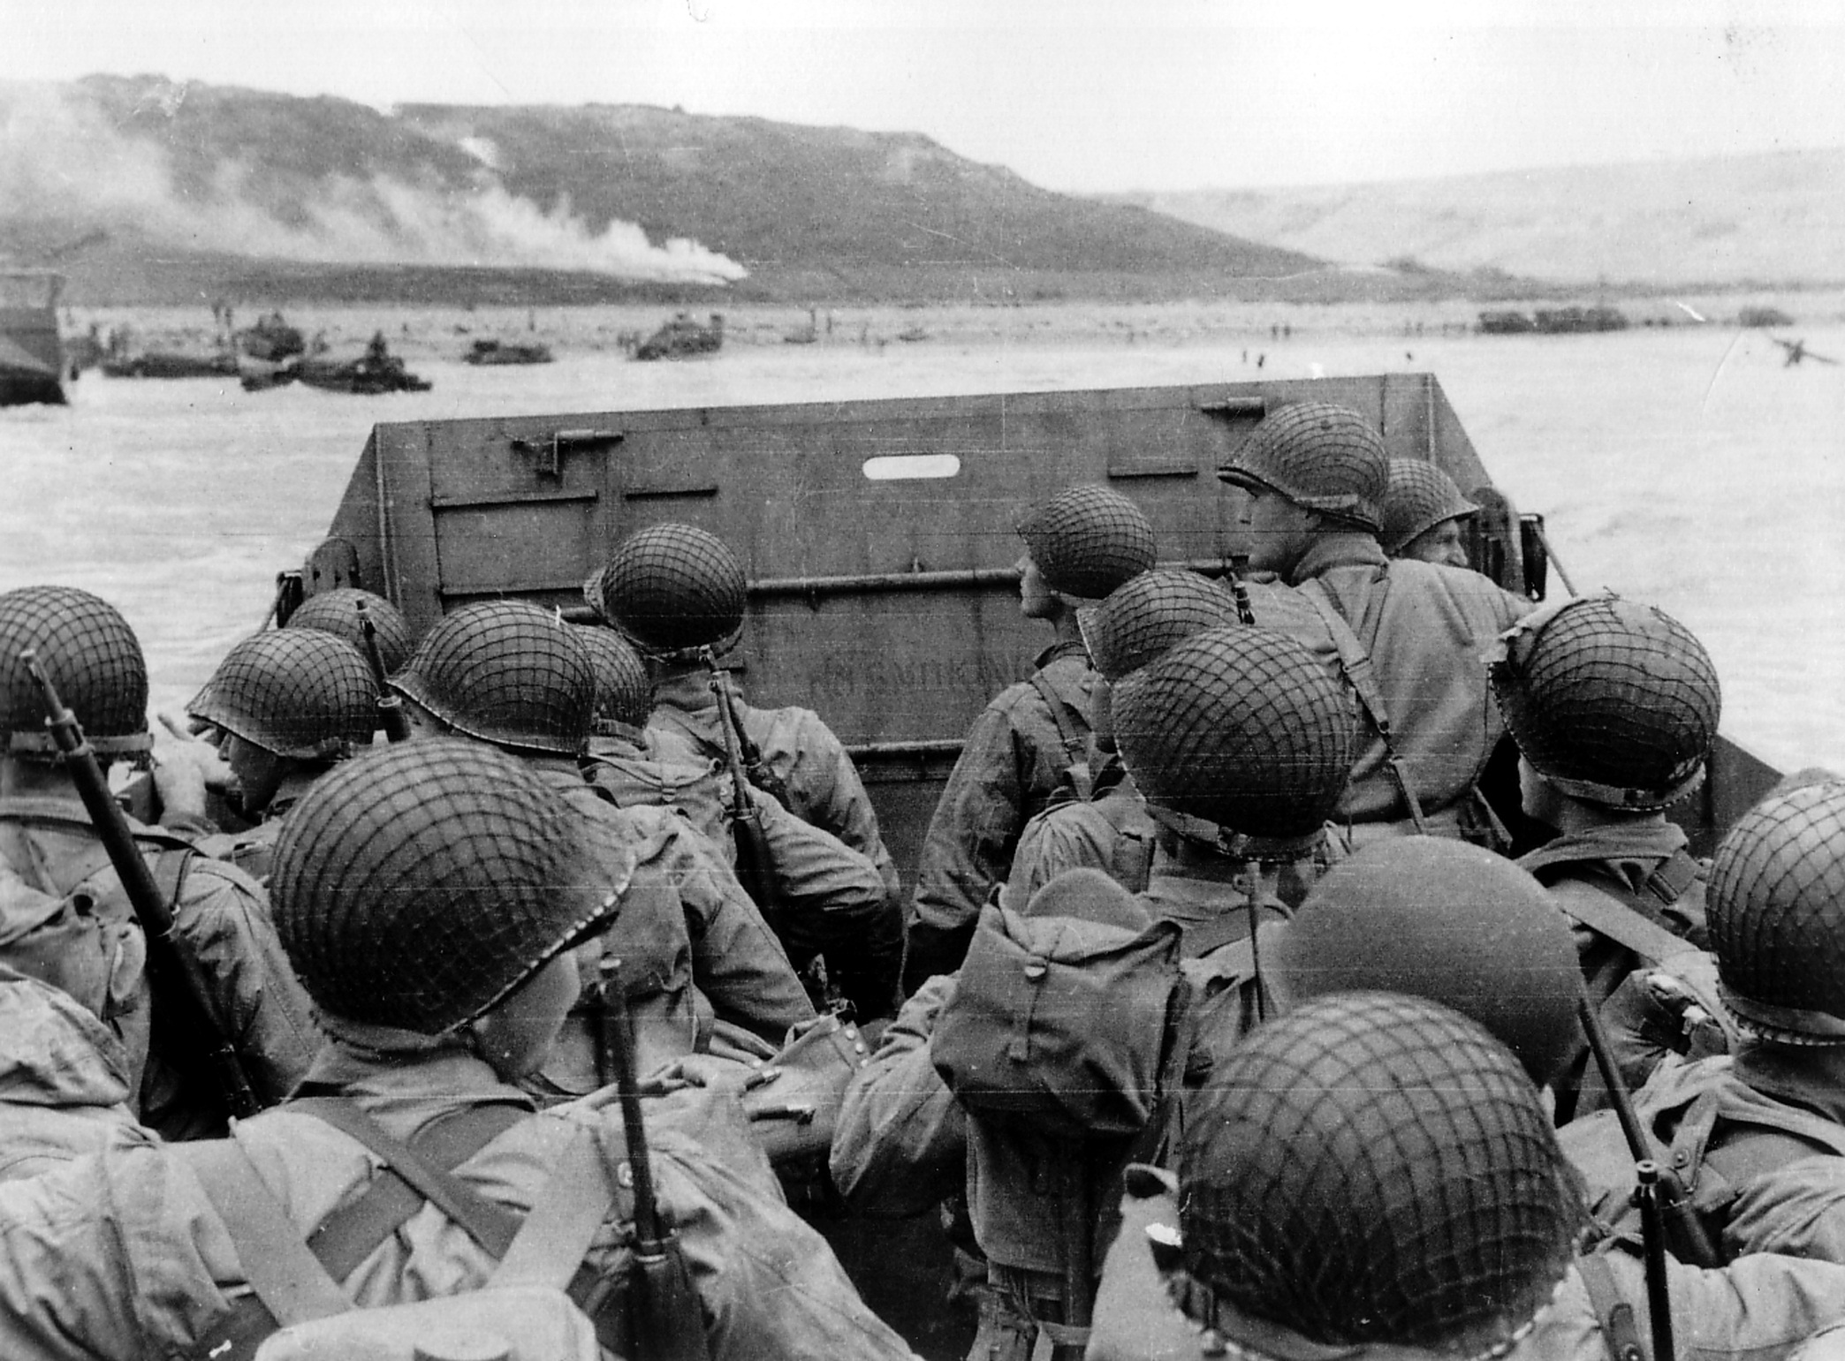

Slide 28
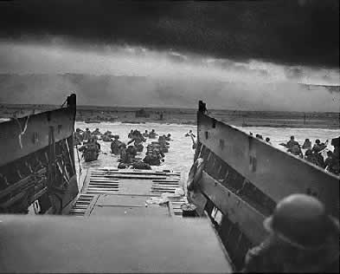

Slide 29
