Slide 1
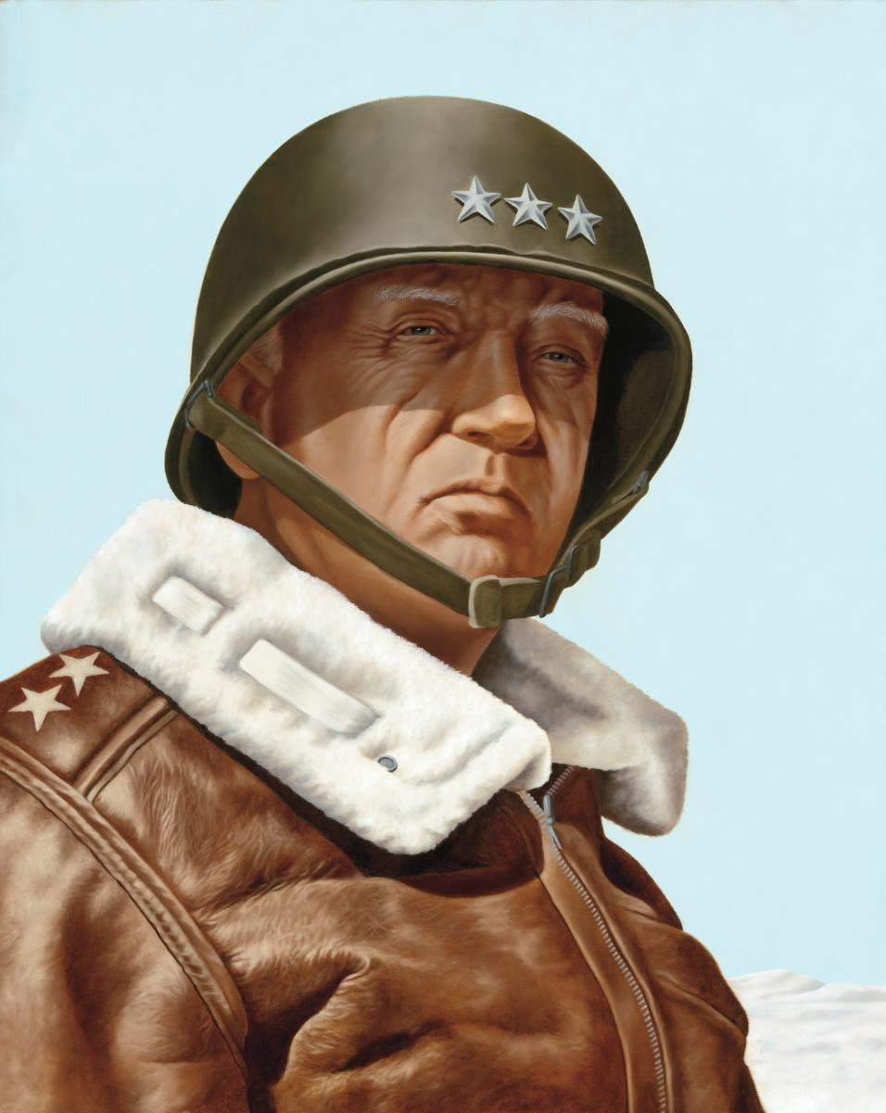
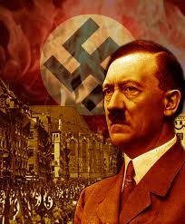
WW II Chapter Notes & Terms

Slide 2
Fascism
Government based on radical nationalism required extreme devotion to state leader and military.
(Totalitarian Dictatorship)

Slide 3
Fuhrer
German name for leader: adopted by Adolf Hitler when he became German Chancellor in 1933.

Slide 4
NAZI
Nationalist Socialist German Workers Party
Created and lead by Adolf Hitler.

Slide 5
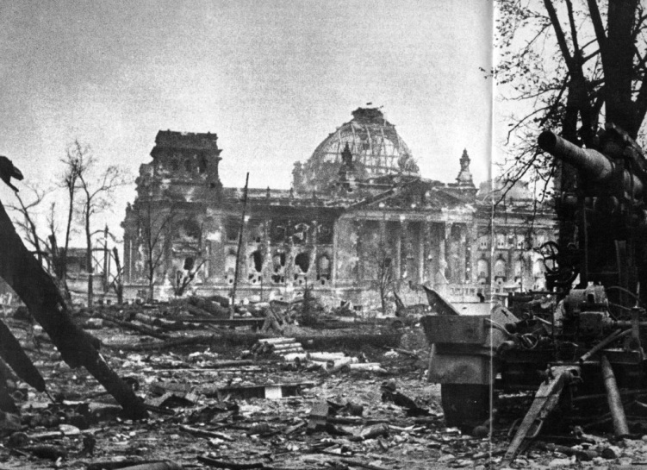
Reich or Reichstag
Hitler's Nazi Germany or Third Empire of Germany
Also a name for the German Chancellery or Parliament building in Berlin

Slide 6
Blitzkrieg
Lightning War: describing all-out method of war - tanks, infantry, artillery, combat engineers and air power, concentrating overwhelming force at high speed to break through enemy lines.

Slide 7
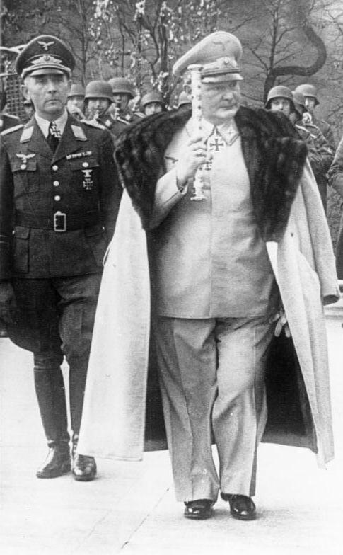
Luftwaffe
German Air Force lead by Herman Goring

Slide 8
Panzer
German Armored Tank

Slide 9
wehrmacht
German Army

Slide 10
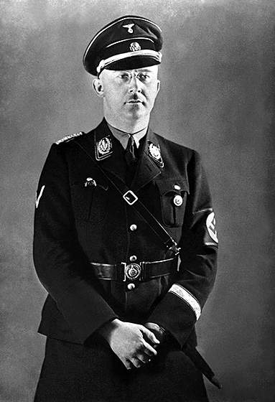
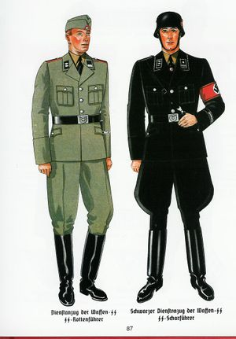
Waffen- SS
Originated as an elite unit used to guard Adolf Hitler and other Nazi Elite. Eventually the SS was lead by Heinrich Himmler and was responsible for carrying out the Holocaust.

Slide 11
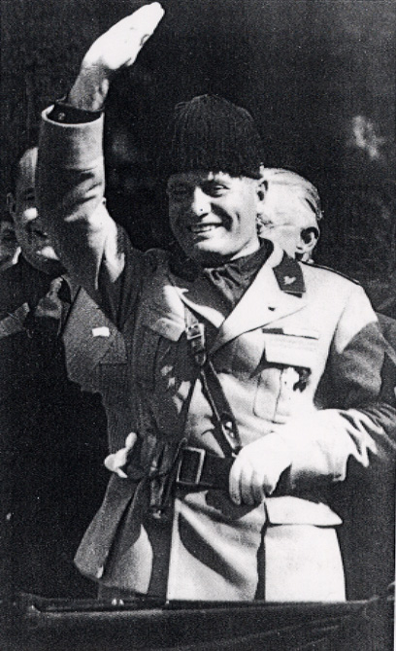
Benito Mussolini
Italy- in political and economic crisis
Had support of middle class seeking stability
Could legislate by decree, police state
Created Young Fascists- Never really in control of all culture/society

Slide 12
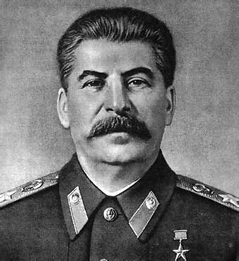
Joseph Stalin
In 1926 became the new Soviet dictator
Attempts to industrialize Russia, turn family farms into collectives (government owned)
If family resisted they eventually starved to death
10 million died from starvation 1932-1933
Stalin tolerated NO opposition
He targeted political enemies, artists, intellectuals
During the 1930’s the USSR was under internal terrorism i.e. forced confessions, fake trials, concentration camps, prisoners used as slave labor, etc

Slide 13
Adolf Hitler
Was anti-communist and admired Mussolini
Fought in WWI and began to despise the Allies & the German government for accepting the terms of the Versailles Treaty
Post war chaos led to the rise of new political parties
One such party was the National Socialist German Worker’s Party or Nazi Party
Party was nationalistic and non-communist & anti-Semitic
Party called for expansion of territory and denial of the Versailles Treaty

Slide 14
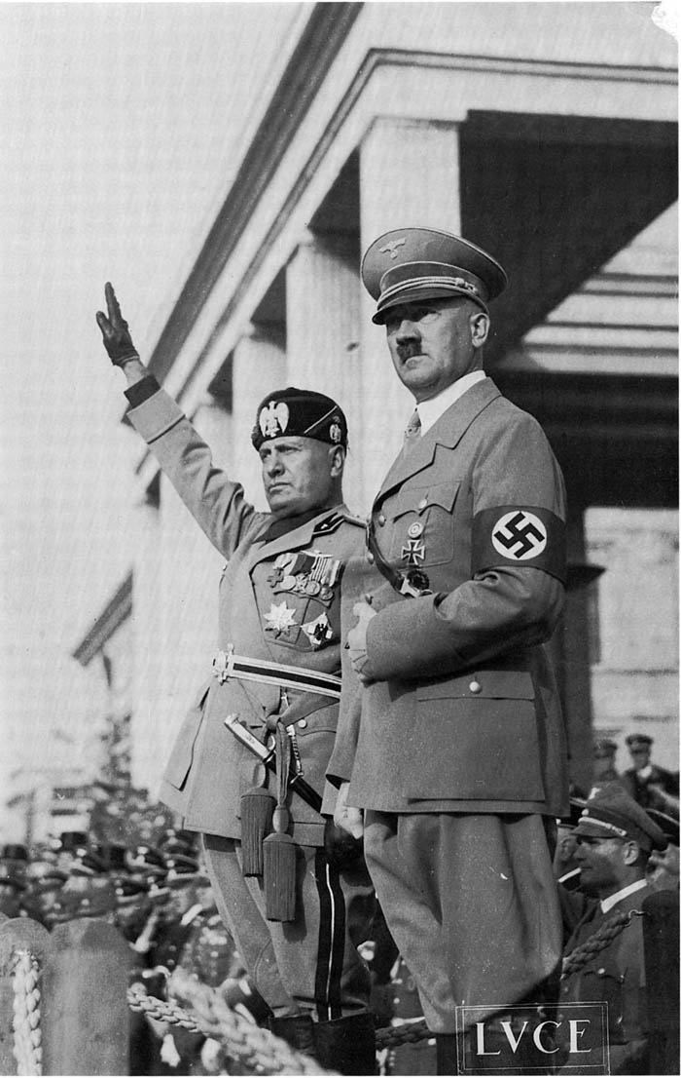
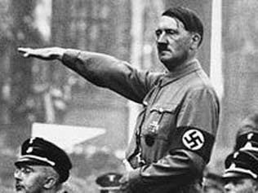
Hitler was arrested for attempting a coup against the German government in 1923. He was jailed for a time where he wrote Mein Kampf with Rudolph Hess

Slide 15
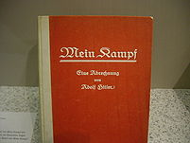
Mein Kampf
Called for the unification or Anschluss of all Germans under one government
He claimed Germans as a master race of people with blond hair & blue eyes known as the Aryans
Argued that Germans needed more space and should expand into Poland & Russia
Believed the Slavic people from eastern Europe were an inferior race who should be enslaved by the Germans
Believed the Jews were responsible for the world’s problems especially for Germany’s defeat in WWI

Slide 16
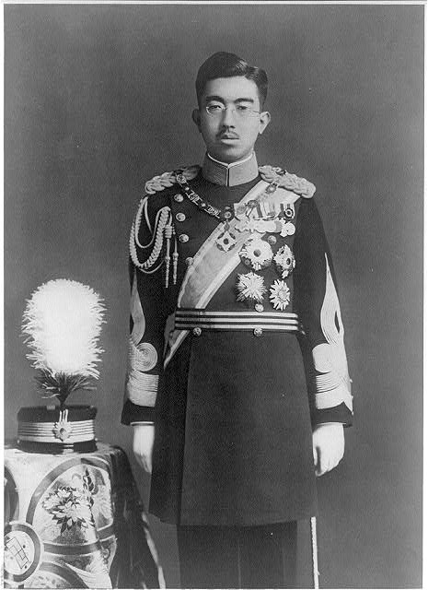
HIROHITO
Hirohito becomes the 124th Emperor of Japan in 1926 (Showa Era)
For the first 19 years of his reign Hirohito allowed a militaristic party to dominate the Japanese government
They opted for expansionism, war with China (1937-45), and military alliance with the Axis powers (1940). The alliance led to Japan's participation in World War II and its attack, Dec. 7, 1941, on the U.S.

Slide 17
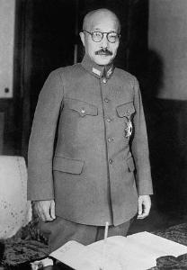
Hideki Tojo
Tojo was the military leader of Japan who became PM in 1941 and within 2 months ordered the attack on Pearl Harbor
Tojo held extreme right-wing views and was a supporter of Nazi Germany. He also feared the long-term plans of Joseph Stalin and in 1938 he advocated pre-emptive air strikes on both China and the Soviet Union.

Slide 18
Causes of WWII
Treaty of Versailles
Germany lost land to surrounding nations
War Reparations
1) Allies collect $ to pay back war debts to U.S.
2) Germany must pay $57 trillion (modern equivalent)
3) Bankrupted the German economy & embarrassed Germans
Hitler Hated the Treaty of Versailles and violated it. First he built up the German military. Then he sent troops into the Rhineland. This was a direct violation of the Treaty of Versailles, which said in 1919 that Rhineland was a demilitarized zone.

Slide 19
March 7yh 1936 Hitler remilitierizes the Rhineland
March 12nd 1938 Anschluss Hitler annexes Autria
Septermber 22nd Hitler takes the Sudatenland from Czechoslovakia
Septemebr 29 1938 (Munich Confefence Hitler takes Chzeslovakia appeasement
sept 1 1939 – Nazi Blitzkreigs invade Poland with 1.8 million troops, 2,600 aircraft and 2000 Tanks compared to 180 Polish Tanks and 420 aircraft
Oct 6th 1939 - ! Month and 5 days later Poland surrendered
April 9th 1939 – Hitler invades Denmark and Norway
May 10th 1940 – Hitler inavades Belgium and Holland
May 26 – June 5th Miracle at Dunkirk takes Place ; 887 ships of all sizes, sometimes dangerously, crossed the English Channel to rescue 338,226 men by bringing them to England.
June 22nd 1940 PRIS FALLS TO THE Nazi
Sept 1940-June 1941 Battle of Britian Takes pLace

Slide 21
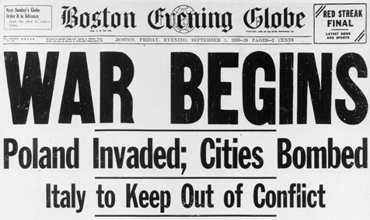
War Begins
On September 1, 1939 Germany invaded Poland without a declaration of war. This starts World War II.

Slide 22
Miracle of Dunkirk
338,000 men were evacuated
Left behind was the English army’s equipment, 90,000 rifles, 7,000 tons of ammunition, & 120,000 vehicles.
Without this equipment, the British could not defend their homeland
Three weeks later, Germany accepted France’s surrender in the same railway car the Germans had surrendered in following WWI.
Hitler now controls the coast of France
Hitler set up a puppet government in France headed by Marshal Philippe Petain.

Slide 23
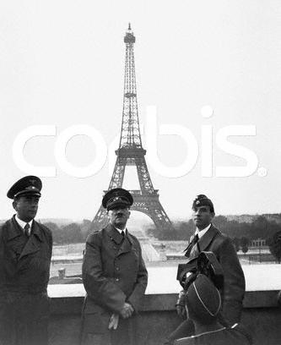
How Did Hitler Make War?
Blitzkrieg “Lightning War”
Used large numbers of tanks to break through enemy positions, waves of aircrafts bombed enemy positions, then dropped paratroopers to cut supply lines
In the next year, Hitler invades:
Denmark
Norway
The Netherlands,
France
Hitler in Paris

Slide 25
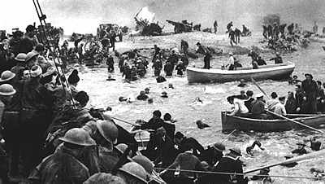
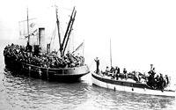
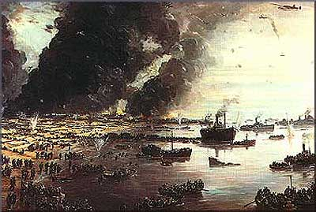
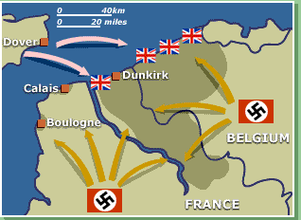
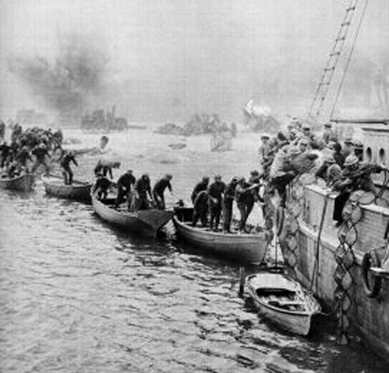
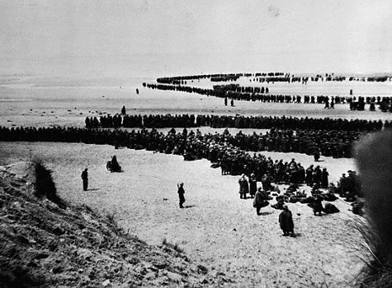

Slide 26
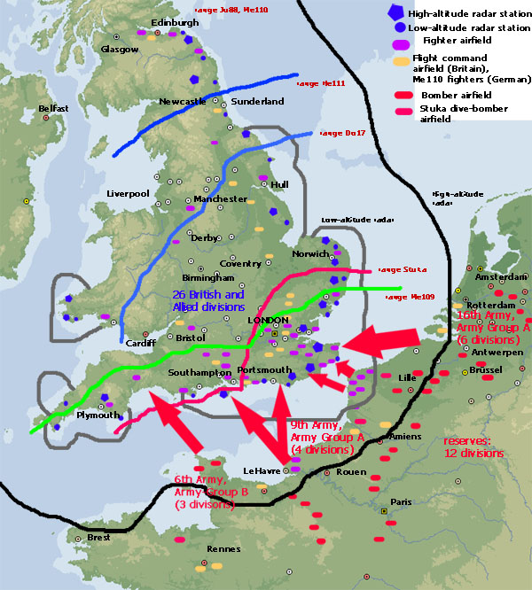
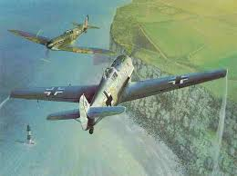
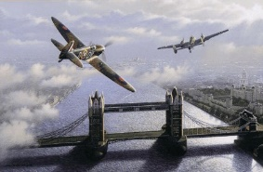
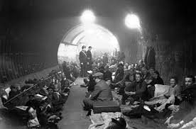
Battle of Britain

Slide 28
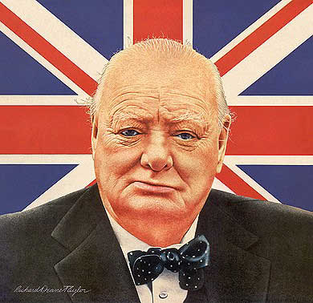
British Leaders
Winston Churchill
PM 1940-1945
Neville Chamberlain
PM 1937-1940

Slide 29
Edging Toward War
FDR lists the Four Freedoms for which the British were fighting for:
freedom of speech
freedom of worship
freedom of want
freedom of fear
Isn’t this democracy?

Slide 30
Lend-Lease Act
Act allows the U.S. to lend or lease arms to any country considered “vital to the defense of the United States”
By the end of the war, the U.S. had loaned more than $40 billion in weapons, vehicles, & other supplies
The Act was also put into place after Hitler invaded the USSR. While Stalin was considered a harsh dictator (communism) the fight against Hitler was more important

